Slide 1

2017 Plan and Bankruptcy Rule Changes & Form 410/410A Guidelines

Slide 2

CFPB
Amendment to Final Mortgage Servicing Rules
Modified Periodic Statements

Slide 3
Consumer Financial Protection Bureau (CFPB)
The CFPB is a government agency established under the provisions of the Dodd-Frank Wall Street Reform and Consumer Protection Act after the 2008 financial crisis
The CFPB was created to protect consumers from unfair, deceptive, or abusive practices and take action against companies that break the law
The CFPB’s creation provides a single point of accountability for enforcing federal consumer financial laws and protecting consumers in the financial marketplace
Prior to the CFPB’s creation, that responsibility was divided among several agencies (e.g., FTC = FCRA; HUD = RESPA)

Slide 4
Consumer Financial Protection Bureau (CFPB)
The CFPB also:
  conducts financial education programs
  Collects, researches, monitors, and publishes information that is relevant to the functioning of markets for consumer financial products and services to identify risks to consumers, and to the proper functioning of those markets
    Bulletins, white papers, research and examination materials
  “may prescribe rules and issue orders and guidance as may be necessary or appropriate to enable the Bureau to administer and carry out the purposes and objectives of the federal consumer financial laws, and to prevent evasions thereof”

Slide 5
CFPB Amendments to Final Mortgage Servicing Rule
On August 4, 2016, the Consumer Financial Protection Bureau (CFPB) released final rules, originally proposed in November 2014, amending nine major areas of the Mortgage Servicing Rules
  Most of the rules are effective 12-months after publication in the Federal Register (October 19, 2017)
  The provisions relating to successors in interest and periodic statements for borrowers in bankruptcy will take effect 18-months after publication in the Federal Register (April 19, 2018)

Slide 6
PERIODIC STATEMENTS: Current Rule
Unless required by a local bankruptcy rule, servicers are exempt from the requirement to provide a periodic statement for a mortgage loan while the consumer is a debtor in bankruptcy
However, 11 USC Sec. 524(j) allows a creditor to “seek or obtain periodic payments associated with a valid security interest in lieu of pursuit of in rem relief to enforce the lien”
As a result, many creditors now choose to send statements to debtors in bankruptcy or who have been discharged, but there is no “safe harbor” for the format of the statements

Slide 7
PERIODIC STATEMENTS:
New Rule
On August 4, 2016 the CFPB issued a final rule amending parts of Reg X and Reg Z of RESPA. Among other things, the rule contains provisions requiring periodic statements in bankruptcy (referred to as “modified periodic statements”), subject to certain exemptions
The new rule becomes effective 18 months after the rule is published in the Federal Register (April 19, 2018)
The rule contains “safe harbor” forms

Slide 8
PERIODIC STATEMENTS: New Rule –
Exemptions from coverage
The final rule applies exemptions at the loan level
  When the criteria for an exemption applies to one borrower on the loan, the servicer is exempt from having to provide a modified periodic statement with respect to any borrower on the loan
Opt in/Opt Out may be in writing or done verbally provided it is documented
  An agent can also submit the request

Slide 9
PERIODIC STATEMENTS: New Rule –
Exemptions from coverage
Fixed rate mortgages if substantially similar information provided on coupon book
  But if the borrower is more than 45 days delinquent, the servicer must provide delinquency information separately in writing, including an account history for the delinquency period
Mortgage loans that are services by small servicers (servicers that service 5,000 or fewer mortgage loans of which servicer or affiliate is creditor or assignee) and state housing finance agencies
Reverse mortgage and timeshare plans
Open-end home loans such as HELOCs

Slide 10
PERIODIC STATEMENTS: New Rule – When can you stop sending statements?
Two part test
  A: Any consumer on the loan must be a debtor or must have been discharged in bankruptcy; AND
  B: One of the following additional conditions must apply:
    1) The consumer requests in writing that the servicer cease providing statements; or
    2) The Filed Plan provides for Surrender, Avoidance, or otherwise does not provide for the payment of arrearage or maintenance of payments; or
    3) The Court enters an order Avoiding lien, lifting the stay, or requiring the servicer to cease providing the statements; or
    4) The consumer files a statement of intention to surrender (11 USC 521(a)) and has not made any partial or periodic payments after filing the case

Slide 11
PERIODIC STATEMENTS: New Rule –
Exemptions from coverage
These exemptions no longer apply if:
The debtor reaffirms the debt; unless there is an order terminating statements
The borrower on the loan requests in writing that statements resume

Slide 12
PERIODIC STATEMENTS: New Rule –
Content of the Statements
The Modified Periodic Statement may allow:
Informational Disclosures
Terminology that is commonly understood or used in the sample
Terminology specific to the circumstances of the case
Regional differences in terminology
A statement identifying the consumer’s status as a debtor in bankruptcy or the discharged status of the mortgage loan
A statement that the periodic statement is for informational purposes only

Slide 13
PERIODIC STATEMENTS: New Rule –
Content of the Statements
The Modified Periodic Statement may allow:
The Amount Due Section does not need to include the amount of any late payment fee and the date on which that fee will be imposed if the payment has not been received
The Delinquency Information Section does not need to include the date on which the consumer became delinquent
A notification of possible risks, such as foreclosure, and expenses, that may be incurred if the delinquency is not cured
A notice of whether the servicer has made the first notice or filing required by applicable law for any judicial or non-judicial foreclosure process
On unmodified statements, the “Amount Due” in the Amount Due Section must be shown more prominently than other disclosures on the page. This “more prominently” requirement does not apply, but the servicer is still required to disclose the “Amount Due”

Slide 14
PERIODIC STATEMENTS: New Rule –
Content of the Statements
Modified Periodic Statement in Chapter 12 & 13:
The first modified statement should include activity since the last statement – since the last payment due
Pre and post petition should be clearly defined and include both
Servicers are not required to alter how they disclose their method of applying payments for purposes of providing a periodic statement to a consumer in bankruptcy
Not all information must appear on the first page and some information may be omitted
A servicer may choose to include additional information on a periodic statement, including bankruptcy-specific information, such as descriptions of agreed orders or additional details about post-petition payments
MAY Omit: account history, loss mitigation, total payments due, and homeownership

Slide 15
PERIODIC STATEMENTS: New Rule –
Content of the Statements
Modified Periodic Statement in Chapter 12 & 13:
Amount Due Must Include:
The monthly payment amount, with a breakdown showing how much, if any, will be applied to principal, interest, and escrow
The total sum of any fees or charges imposed since the last statement
Any payment amount past due; however, information on agreed orders is discretionary and servicers may opt to list post petition fees, costs and charges after compliance with Rule 3002.1

Slide 16
PERIODIC STATEMENTS: New Rule –
Content of the Statements
Modified Periodic Statement in Chapter 12 & 13:
The Transaction Activity Must Include
All payments the servicer has received since the last statement
  All post- petition and pre-petition payments
All payments of post-petition fees and charges
All post- petition fees and charges the servicer has imposed since the last statement
*The brief description of the activity need not identify the source of any payments

Slide 17
PERIODIC STATEMENTS: New Rule –
Content of the Statements
Modified Periodic Statement in Chapter 12 & 13:
Pre-petition Arrearage Breakdown:
If applicable, the total of all pre-petition payments received since the last statement
The total of all pre-petition payments received since the beginning of the consumer’s bankruptcy case
The current balance of the consumer’s pre-petition arrearage
The pre- petition arrearage disclosures must be grouped in close proximity to each other and located on the first page of the statement or, alternatively, on a separate page enclosed with the periodic statement or in a separate letter
The CFPB believes that the pre-petition arrearage disclosure does not need to include a breakdown of principal, interest, and escrow

Slide 18
PERIODIC STATEMENTS: New Rule –
Content of the Statements
Disclosures to Consumers in Chapter 12 & 13:
When applicable use the following disclosures:
Section 1026.41(f)(3)(vi)(A) requires a statement that the amount due includes only post-petition payments and does not include other payments that may be due under the terms of the consumer’s bankruptcy plan
Section 1026.41(f)(3)(vi)(B) provides that, if the consumer’s bankruptcy plan requires the consumer to make the post-petition mortgage payments directly to a bankruptcy trustee, the periodic statement must include a statement that the consumer should send the payment to the trustee and not to the servicer

Slide 19
PERIODIC STATEMENTS: New Rule –
Miscellaneous Provisions
Multiple Obligors
  In connection with a mortgage loan with more than one primary obligor, the servicer may provide the modified statement to any or all of the primary obligors, even if a primary obligor to whom the servicer provides the modified statement is not a debtor in bankruptcy
Coupon book
  Include disclosures set in the rule, on same page or separate page
  Similar disclosures to modified periodic statements
Exclusive Address:
  Servicer can establish for opt in/opt out provided that the servicer notifies the consumer of the address in a manner that is reasonably designed to inform the consumer of the address and uses the same address both for opt-ins and opt-outs

Slide 20
PERIODIC STATEMENTS: New Rule –
Billing Transaction Timeline
A servicer is not required to transition to a modified or unmodified periodic statements if the payment due date for that billing cycle is no more than fourteen (14) days after the date on which the trigger event occurs
Single billing cycle exemption: When a servicer transitions from a modified or unmodified statement the servicer must provide the next modified or unmodified period statement by delivering the statement within a reasonably prompt time after the first due date after the triggering event that is more than fourteen (14) days after the date on which the applicable event occurs
Reasonably Prompt: delivering, emailing, or placing the periodic statement in the mail within four days after the payment due date or the end of the courtesy period generally would be considered reasonably prompt

Slide 21
PERIODIC STATEMENTS: New Rule –
Billing Transaction Timeline
Best Practice:
Create and test forms for periodic statements to use for loans in bankruptcy per the proposed Model Forms for Chapter 7, Chapter 11 cases and for Chapter 12, Chapter 13 cases as early as possible to meet the anticipated compliance date of January 1, 2018

Slide 22
More Changes Coming
Form 113 & 2017 Rule Changes
A national Chapter 13 form plan (hereinafter, referred to as the “Form 113”) and accompanying rule changes went through two public comment periods and were approved by the Supreme Court
Effective implementation of the form plan required conforming amendments to Federal Bankruptcy Rules 2002, 3002, 3007, 3012, 3015, 4003, 5009, 7001, and 9009

Slide 23
More Changes Coming
New Rule 3015.1
Each district could choose to opt-out from Form 113 and adopt a conforming plan
To properly opt out, a district needed to publish a proposed plan for public comment
The decision had to be made by December 1st, 2017 (some made the decision late)
If no decision is made, the default plan was Form 113

Slide 24
More Changes Coming
New Rule 3015.1
If a district opted out from Form 113, some of the requirements for a conforming plan include:
  Each paragraph would need to be numbered;
  If the plan provides for surrender of collateral, the plan must include a request for termination of the stay;
  Non standard provisions can appear in only one place or section, otherwise the provisions would be ineffective
  The Debtor or Debtor’s attorney must certify there are no non standard provisions other than those in the designated section for non standard provisions

Slide 25
More Changes Coming
New Rule 3015.1
At last count, all but 12 (out of 94) opted out of the national plan (Form 113)
The districts adopting Form 113 are:
  Western Kentucky
  Western New York
  Western Virginia
  Northern Illinois
  Northern Ohio
  Northern Indiana
  Northern Iowa
  Southern Iowa
  Utah
  Wyoming
  Vermont
  US Virgin Islands

Slide 26
More Changes Coming
Rule 3002
When must the PoC be filed?
Rule 3002 is amended to clarify that secured creditors MUST file a POC in order to have an allowed secured claim and receive distributions
The current draft of Rule 3002(c)(2) provides that for the debtor’s principal residence, the POC is timely filed if filed within 60 70 days of the petition date and includes the mortgage form attachment required by Rule 3001(c)(2)(c).
  The documentation required by Rule 3001(c)(1) and (d) (supporting documents) may be filed as a supplement no later than 120 days after the petition.

Slide 27
More Changes Coming
Rule 3002
A lien that secures a claim against the debtor is not void due only to the failure of any entity to file a proof of claim
The court may extend the time to file a proof of claim “by not more than 60 days from the date of the order granting the motion” if the creditor had insufficient notice
  Query: does this mean a court cannot extend the time for other reasons?

Slide 28
More Changes Coming
Form 113 & 2017 Rule Changes
What controls – the plan or the PoC?
Form 113 provides that the amounts listed on a POC as to the current installment payment and the arrearage for secured claims will control over contrary amounts listed in the plan
What if the district opted out of Form 113?
Most districts provide in their conforming plan that the PoC controls (e.g., all 3 Tennessee plans provide for this)

Slide 29
More Changes Coming
Rule 3012
What controls – the plan or the PoC?
Rule 3012 - the amount of a claim that is secured (i.e., value) or entitled to priority status may be determined in a proposed plan, subject to objection and resolution at the confirmation hearing
Where modification is proposed by the plan, the plan must be served per Rule 7004.

Slide 30
More Changes Coming
Rule 3007
Rule 3007 now provides that an objection to claim must conform to the official form and be served at least 30 days before any scheduled hearing at the notice address on the latest proof of claim or amended proof of claim
Service on an insured depository institution must be pursuant to Rule 7004 (i.e., certified mail)

Slide 31
More Changes Coming
Rule 2002
Other changes:
Rule 2002 was amended and 3015(f) was added to designate a notice of plan objection deadline and the actual plan objection deadline, which will be 7 days prior to confirmation, unless the court orders otherwise.
  Can creditors meet this deadline?
  What if the debtor doesn’t check the appropriate box in Part 1?

Slide 32
Revised
Proof of Claim Forms
Form 410A – Replaced PoC Attachment
  Only required if loan is secured by principal residence
  A detailed payment history beginning with the first date of default
  The disclosure requirements should be uniform nationwide; local variations should be prohibited
  The amount of regular monthly mortgage payment as of the petition date should be included
  Calculation of the total claim should be shown

Slide 33
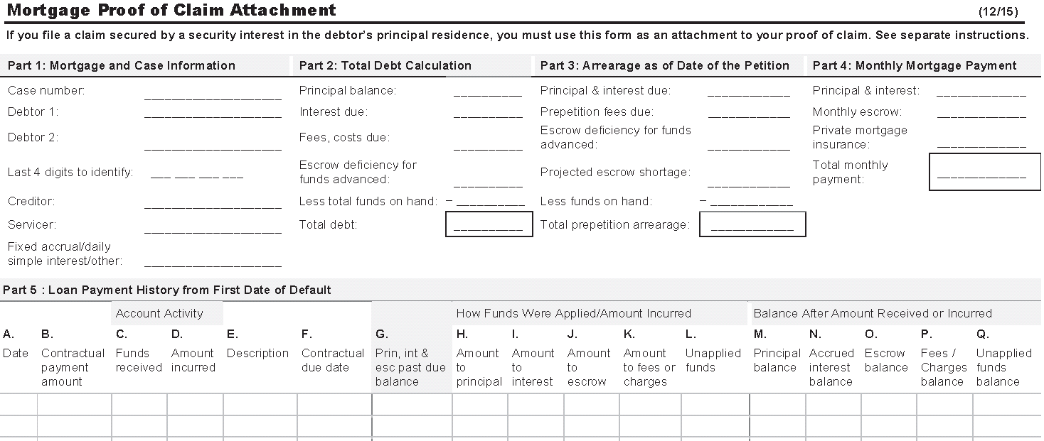
Revised
Proof of Claim Forms
Form 410A – Replaces PoC Attachment

Slide 34
Revised
Proof of Claim Forms
Form 410A – Part 3
Arrearage as of the Date of the Petition

Slide 35
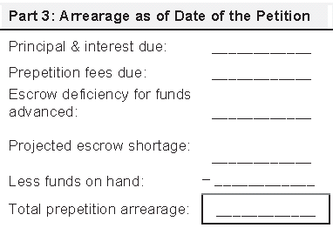
Revised
Proof of Claim Forms
Form 410A – Part 3
Arrearage as of the Date of the Petition:
Insert the amount of the principal and interest portion of all prepetition monthly installments that remain outstanding as of the petition date
The escrow portion of prepetition monthly installment payments should NOT be included in this figure

Slide 36
Revised
Proof of Claim Forms
Form 410A – Part 3
Arrearage as of the Date of the Petition:
Insert the amount of fees and costs outstanding as of the petition date
  This amount should equal the Fees/Charges balance as shown in the last entry in Part 5, Column P

Slide 37
Revised
Proof of Claim Forms
Form 410A – Part 3
Arrearage as of the Date of the Petition:
Insert any escrow deficiency for funds advanced
  This amount should be the same as the amount of escrow deficiency stated in Part 2

Slide 38
Revised
Proof of Claim Forms
Form 410A – Part 3
Arrearage as of the Date of the Petition:
IMPORTANT
The escrow deficiency amount (i.e., the negative balance in the escrow account on the day the case was filed) is ordinarily the starting balance for the escrow analysis
Although not spelled out in the instructions, it has been determined that because the escrow deficiency is being listed on a separate line in Part 3, the escrow account needs to be brought up to zero prior to running the escrow analysis
This may require a programming change for the first escrow analysis run after the filing of a bankruptcy case

Slide 39
Revised
Proof of Claim Forms
Form 410A – Part 3
Arrearage as of the Date of the Petition:
Insert the projected escrow shortage as of the date the bankruptcy petition was filed (should be based on and consistent with escrow analysis performed as of the date of the petition under Rule 3001)
The calculation should include 1/6 of the anticipated annual charges against the escrow account or 2 months of the monthly pro rata installments due by the borrower as calculated under RESPA guidelines

Slide 40
Revised
Proof of Claim Forms
Form 410A – Part 3
Arrearage as of the Date of the Petition:
  The shortage is the difference between the actual amount in the escrow account and the required amount
  The amount actually held should equal the amount of a positive escrow account balance as shown in the last entry in Part 5,Column O

Slide 41
Revised
Proof of Claim Forms
Form 410A – Part 3
Arrearage as of the Date of the Petition:
IMPORTANT
  The escrow portion of missed prepetition mortgage payments will not be recovered as a separate line item

Slide 42
Revised
Proof of Claim Forms
Form 410A – Part 3
Arrearage as of the Date of the Petition:
Insert the amount of funds on hand as of the petition date
Subtract this number from the total amounts due listed in Part 3 to arrive at the Total Prepetition Arrearage

Slide 43
Revised
Proof of Claim Forms
Form 410A – Part 4
Monthly Mortgage Payment

Slide 44
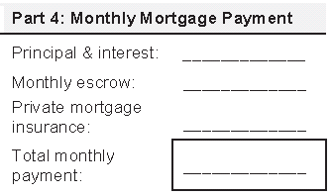
Revised
Proof of Claim Forms
Form 410A – Part 4
Monthly Mortgage Payment:
The Total Monthly Payment is the sum of the principal and interest, monthly escrow, PMI, and other amounts (e.g., credit life insurance)
The monthly escrow should not include any shortage or deficiency from Part 3

Slide 45
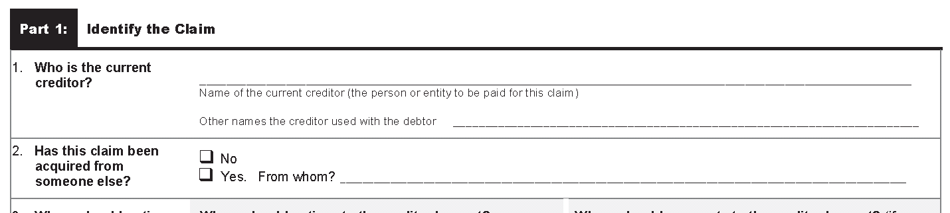
Proofs of Claim
NACTT Guidelines – Form 410
Box 1 is for identifying the creditor
Other Names – not for transfers, but could include a name change

Slide 46
Proofs of Claim
NACTT Guidelines – Form 410
  Box 2 of Part 1 of Form 410 should only be checked Yes if the claim was acquired by the entity filing the PoC after the filing of the bankruptcy case

Slide 47
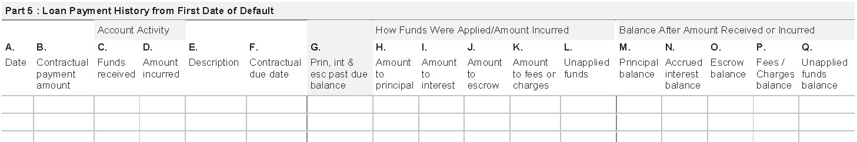
Proofs of Claim
NACTT Guidelines – Form 410A
Loan Payment History from the First Date of Default
Beginning with the First Date of Default, enter:
  the date of the default in Column A
  amount incurred in Column D
  description of the charge in Column E
  principal balance, escrow balance, and unapplied or suspense funds balance as of that date in Columns M, O, and Q, respectively

Slide 48
Proofs of Claim
NACTT Guidelines – Form 410A
For:
  (1) all subsequently accruing installment payments;
  (2) any subsequent payment received;
  (3) any fee, charge, or amount incurred; and
  (4) any escrow charge satisfied since the date of first default
Enter the information in date order, showing:
  the amount paid, accrued, or incurred
  description of the transaction
  contractual due date
  how the amount was applied or assessed
  the resulting principal balance, accrued interest balance, escrow balance, outstanding fees or charges balance, and the total unapplied funds held or in suspense

Slide 49
Revised
Proof of Claim Forms
NACTT Guidelines – Form 410A
Loan Payment History from the First Date of Default
  There is no reason the history cannot start the month before the first date of default (to show when the loan was last current).

Slide 50
Revised
Proof of Claim Forms
NACTT Guidelines – Column N
Loan Payment History from the First Date of Default
Column N is for showing the accrued (i.e., running) interest balance for daily simple interest loans

Slide 51
Proofs of Claim
NACTT Guidelines – Funds on Hand
Funds on Hand:
  The field in Part 3 of Form 410A entitled “Less Funds on Hand” should be populated with the amount of funds in suspense at the time of the bankruptcy filing

Slide 52
Proofs of Claim
NACTT Guidelines – Funds on Hand
Funds on Hand:
    Unlike Part 2 of Form 410A, this field should not include a positive balance in the escrow account

Slide 53
Proofs of Claim
NACTT Guidelines – Funds on Hand

Slide 54
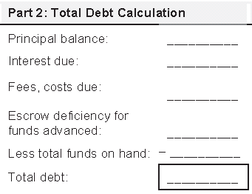
Proofs of Claim
NACTT Guidelines – Funds on Hand
Funds on Hand
In Part 2, the label is Total amount of funds on hand.
This amount is the total of the following, if applicable:
a positive escrow balance,
unapplied funds, and
amounts held in suspense accounts

Slide 55
Proofs of Claim
NACTT Guidelines –Reverse Mortgages
Monthly Mortgage Payment
Part 4 of Form 410A should be left blank

Slide 56
Proofs of Claim
NACTT Guidelines –Reverse Mortgages
Arrearage as of the Date of the Petition
Part 3 should only reflect a balance if there are advances to be recovered

Slide 57
Proofs of Claim
NACTT Guidelines – Loan Mods
  Loans that are in a Trial Modification are not considered current for purposes of determining the first date of default for Part 5
  A loan that has been permanently modified and which capitalizes all the delinquency, including fees and costs, is considered current as of the effective date of the loan modification for purposes of determining the first date of default for Part 5

Slide 58
Proofs of Claim
NACTT Guidelines – Loan Mods
Post-Petition Loan Modification: Loan is considered current if all the delinquency is capitalized in loan modification
Reviewing for APOC filing: Form 410A Parts 1-4
Form 410A Part 5 does not need to be completed

Slide 59
Proofs of Claim
NACTT Guidelines – Permanent Mod
Review for APOC filing: Form 410A Parts 1-4
Form 410A Part 5 does not need to be completed

Slide 60
Proofs of Claim
Loss Mitigation / Amended PoCs
Court Approval on Post-Petition Loan Mods
Varies by Jurisdiction
For Jurisdictions requiring Court Orders on Motions to Approve Post-Petition Loan Modifications, APOC referral should be immediately launched once Order is filed
UST Inquiries: Servicer delay in booking loan modification in system and filing Motion to Approve and APOC

Slide 61
Proofs of Claim
Loss Mitigation / Amended PoCs
APOCs for Loan Modifications:
Deferred Principal Balance
Attach Loan Modification to APOC filing but the Security Instrument and the Note are not required to be attached to APOC filing
Service Transfers:
Need to be aware of any loan modifications or trial modifications offered to debtor by prior servicers

Slide 62
Proofs of Claim
Loss Mitigation / Amended PoCs
Trustee Disbursements on Claim:
Additional Language is Included on Claim to Advise Trustee whether any funds will be refunded to Trustee’s Office
Amount necessary to cure any default: $0* The amount prepetition arrearage paid by the Trustee up the loan modification interest start date___. No further arrearages to be paid by the Trustee. A refund in the amount of ____will be sent to the Trustee
Effective Date of Loan Modification
UST Inquiries: Servicer delay in refunding funds to Trustee’s office which were capitalized in loan modification
Objections to Claim for Post-Petition Loan Modifications:
Advise that Response be filed advising on the status of Loan Modification and APOC will be filed once loan modification finalized

Slide 63

2017 NACTT Mortgage Committee Meeting:
Proposal of the Loan Modification Subcommittee

Slide 64
Proposal of the Loan Mod Subcommittee
Issues
  Bankruptcy can interfere or conflict with the loan mod process
  The bankruptcy approval process varies by jurisdiction
  Many steps are involved
    Amend the Proof of Claim
    File a Notice of Payment Change
  Trial Mods require payments be made timely
  Who has standing to seek approval of a loan modification?

Slide 65
Proposal of the Loan Mod Subcommittee
Goals
  Adopt a process that:
  Streamlines loan mod approval
  Standardizes loan mod approval
  Provides the information needed by trustees to administer the claim and post-petition payments
  Allows for servicers to seek approval of the loan modification
  Allows for flexibility in case a jurisdiction prefers additional steps
  can easily and willingly be adopted by servicers.

Slide 66
Proposal of the Loan Mod Subcommittee
Solution
  After the debtor and debtor’s attorney agree to a loan mod or to participate in a trial mod:
  File one motion entitled “Motion to Approve Temporary Forbearance of Claim”
  The court enters an interim order (preferably in the form of a consent order) establishing the amount and destination of trial payments
  The interim order continues the hearing until a decision is made on the loan mod
  If the loan is permanently modified, at the continued hearing a second and final order “approves” the terms of the loan modification, sets the amount of the monthly payment, and amends the arrearage claim

Slide 67
Proposal of the Loan Mod Subcommittee
Benefits
  Only one motion is needed
  The process accommodates trial modifications and provides trustees with the information needed at the trial stage
  There is no longer a need to amend the claim
  There is no longer a need to file a notice of payment change
  Servicers and their attorneys can file the motion (i.e., no need to wait for the debtor’s attorney)

Slide 68
Questions?

Slide 69

Thank you

