Slide 1
Foreclosure 101 - Intro

Slide 2
Judicial
Foreclosure

Slide 3
Judicial Foreclosure in under 5 minutes

Slide 6
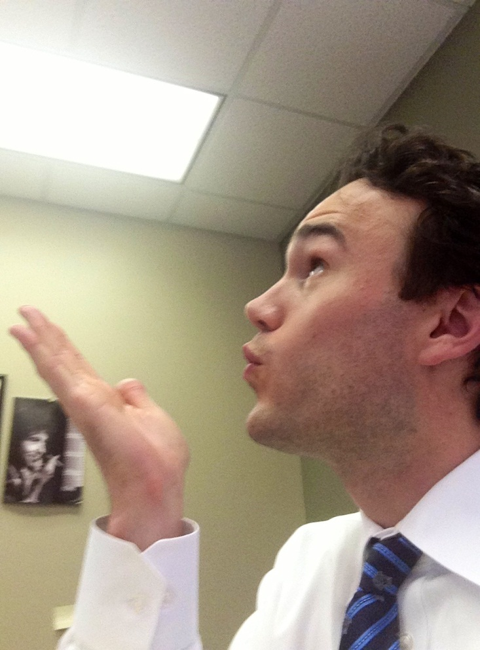

Slide 7
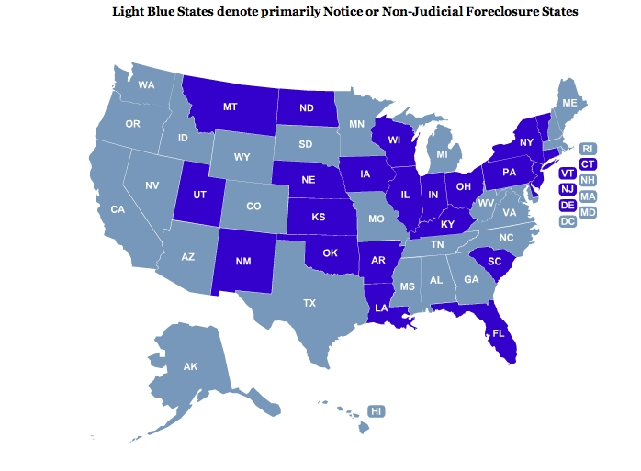

Slide 8
This may seem obvious

Slide 11
MY ACTUAL BABY
MY ACTUAL CHILDREN

Slide 13
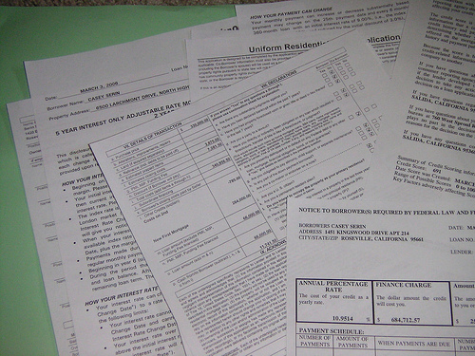

Slide 14
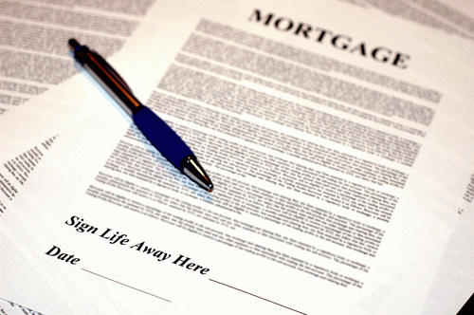

Slide 15
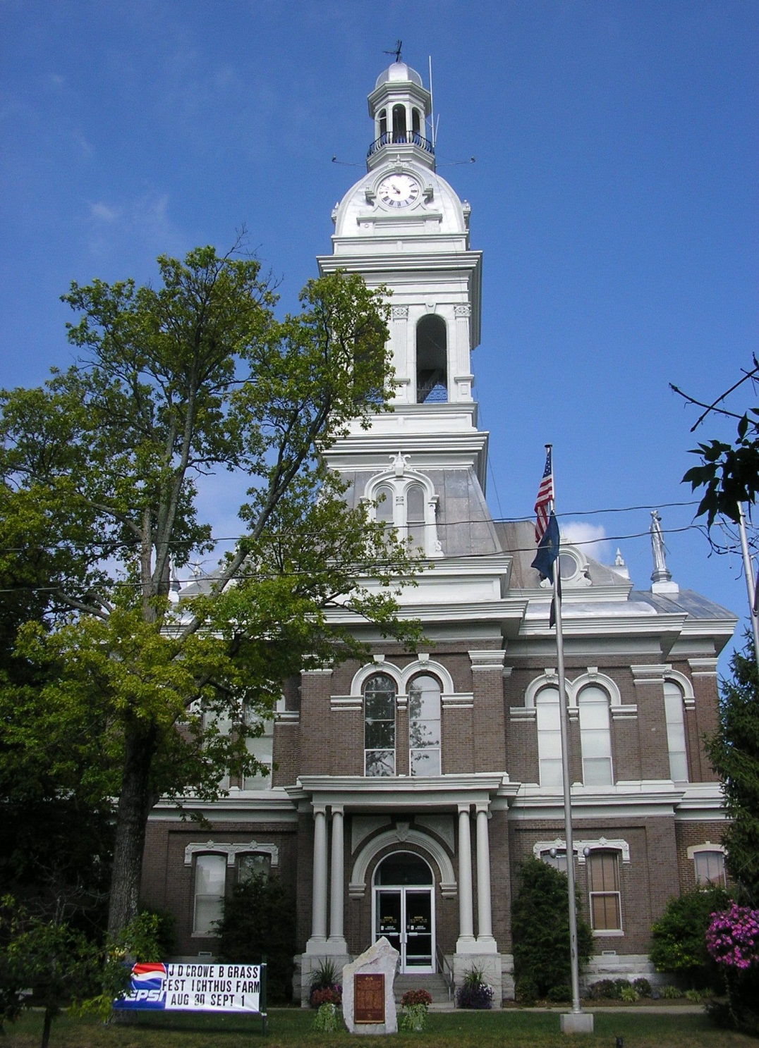

Slide 16
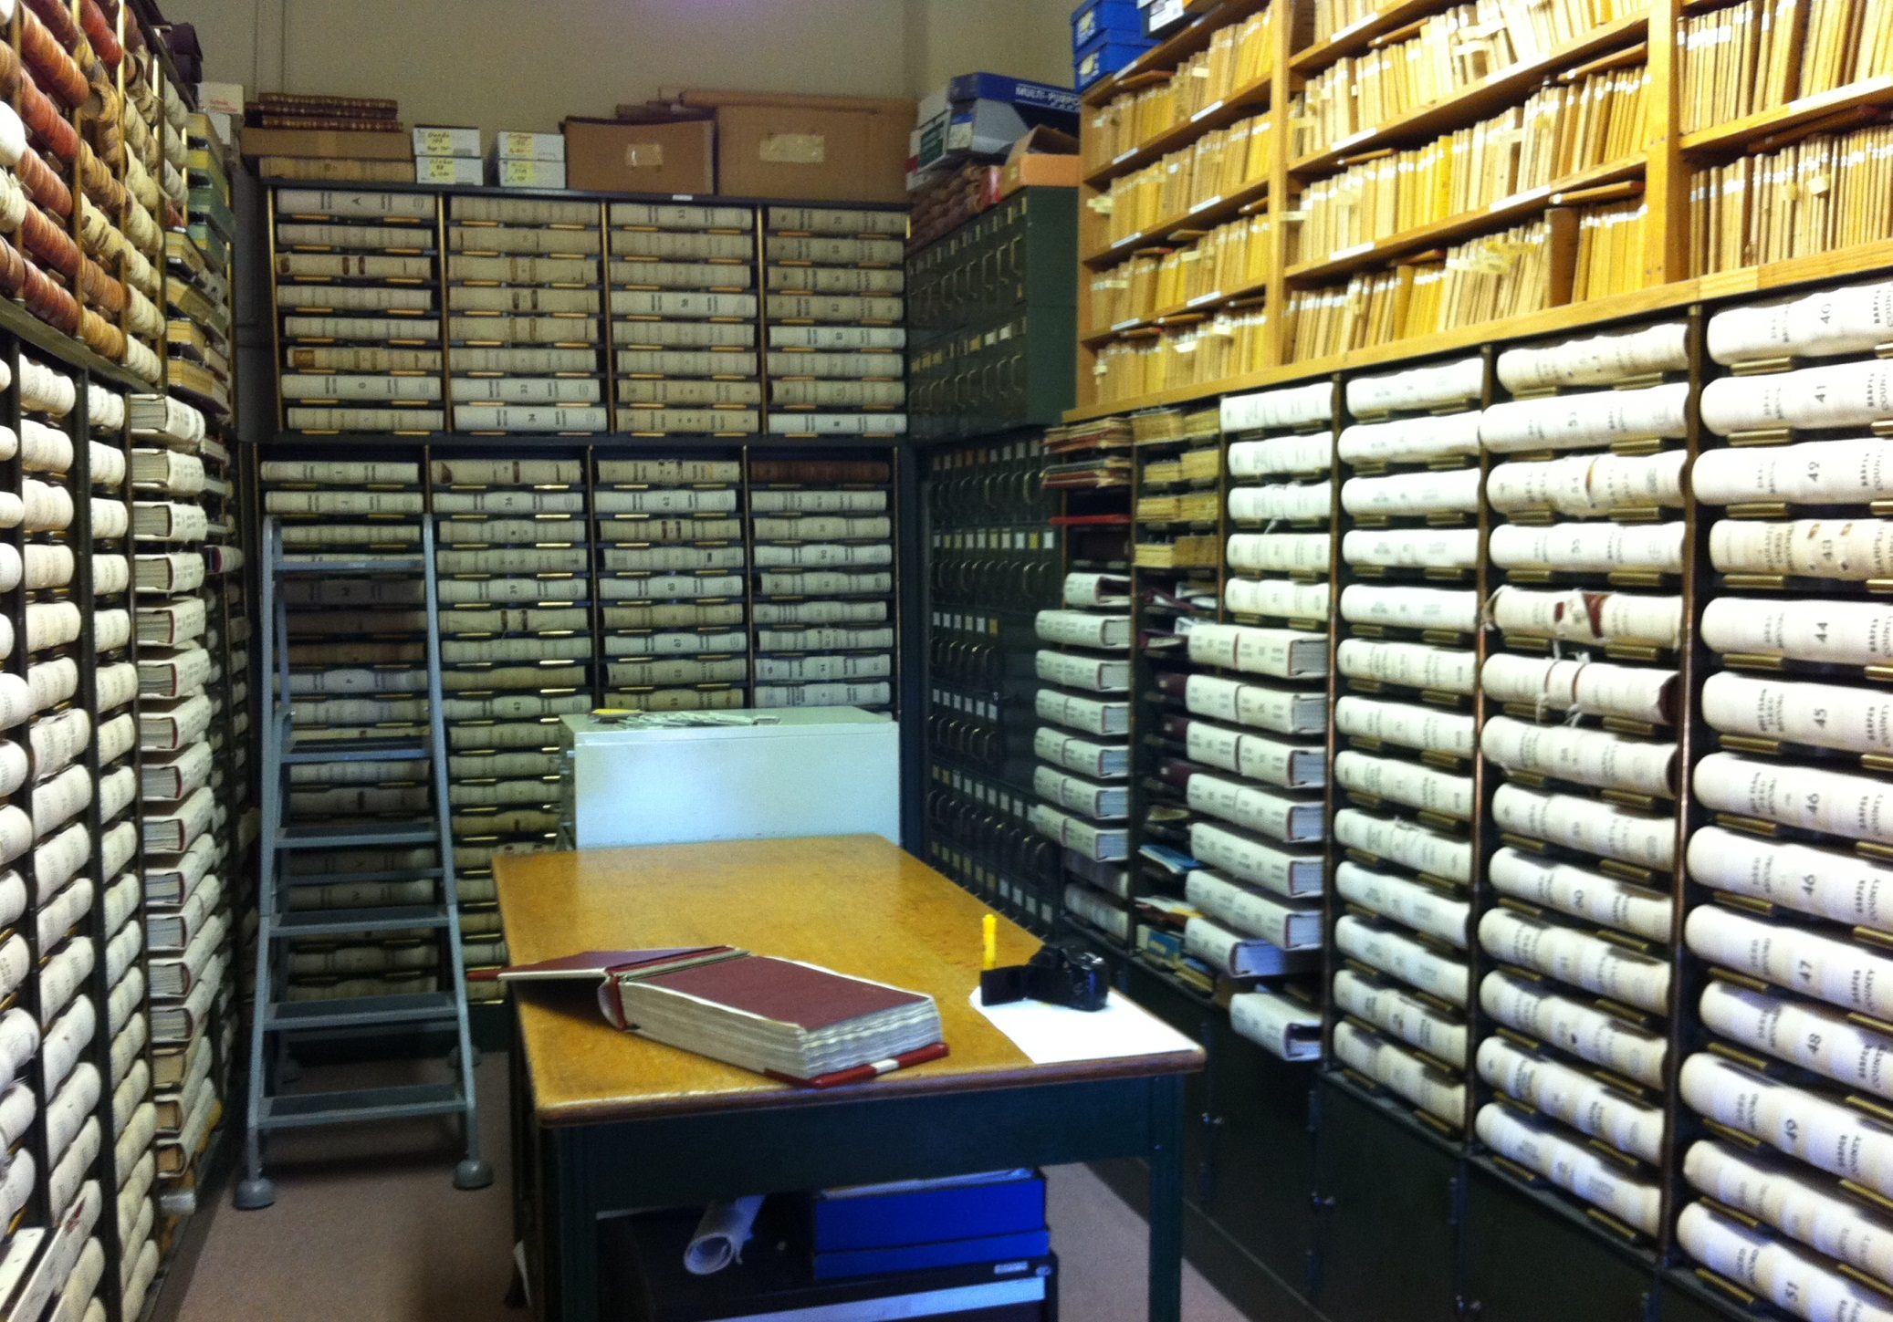

Slide 17
(Actual County Clerk)

Slide 18
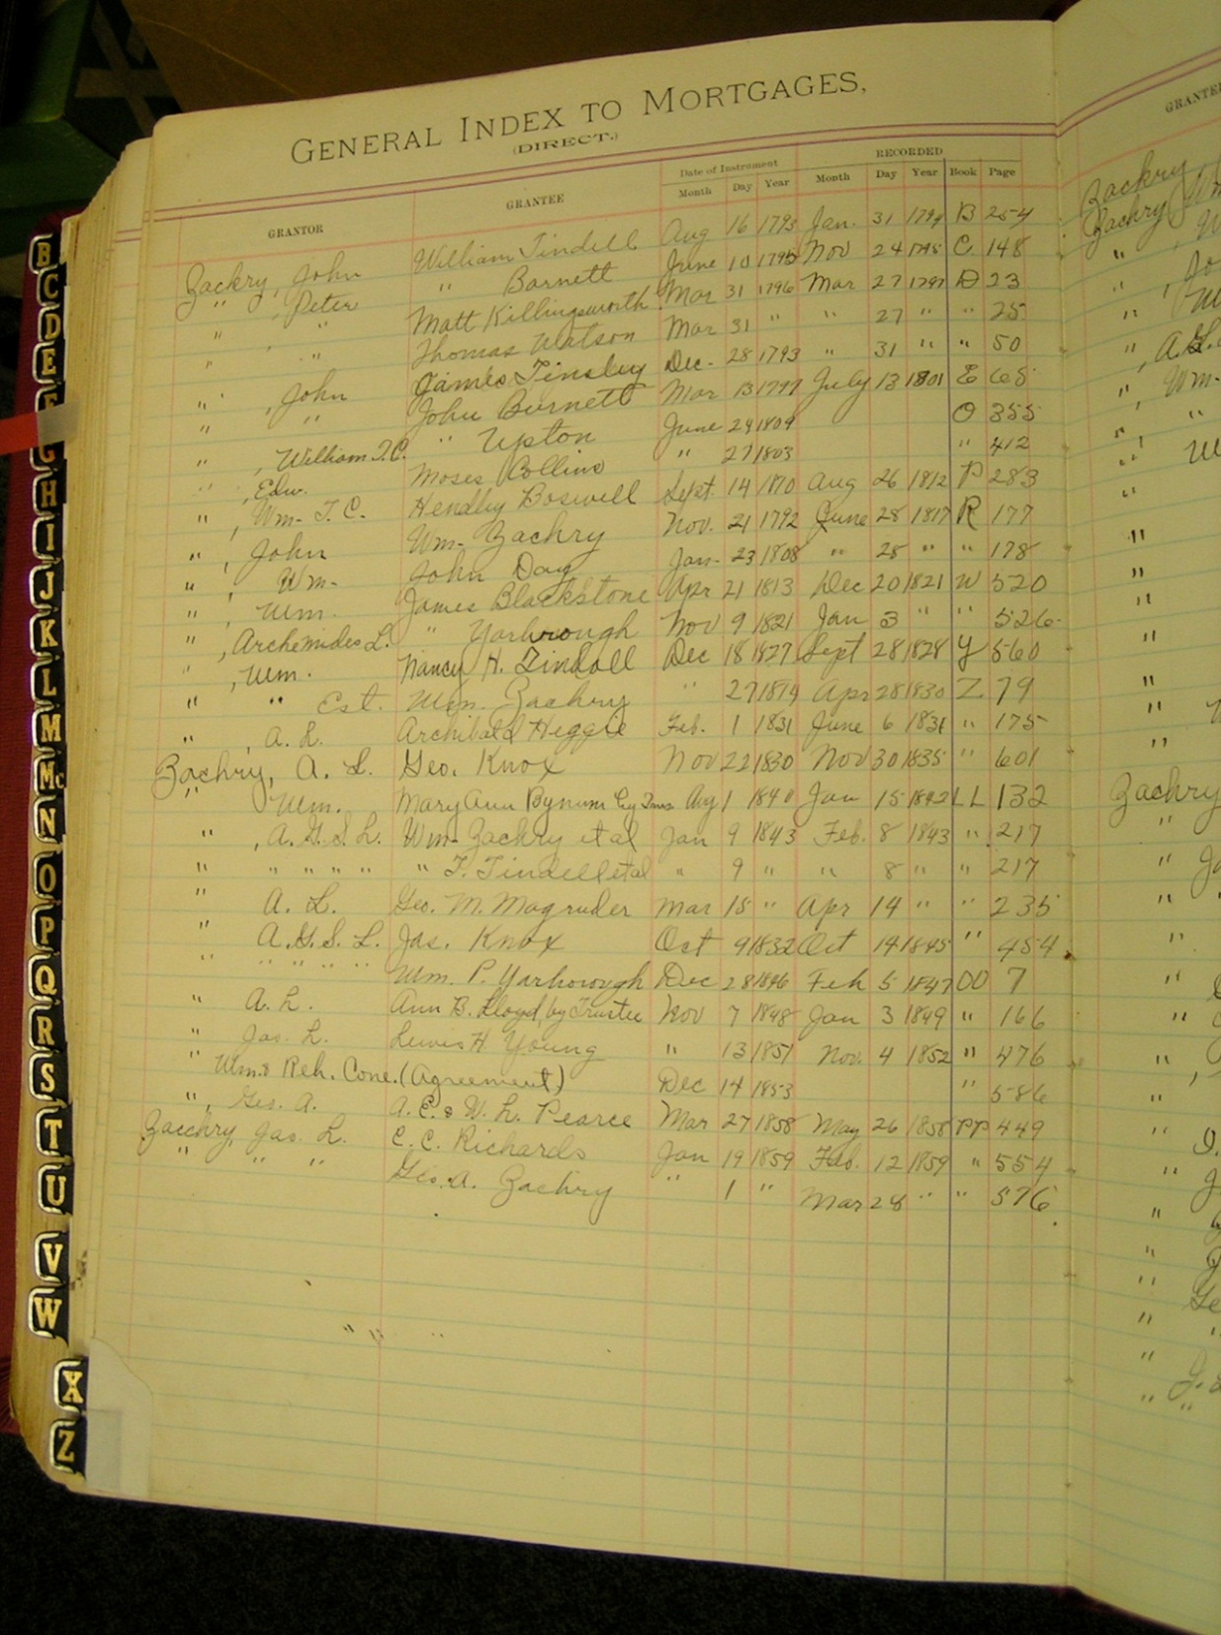

Slide 20
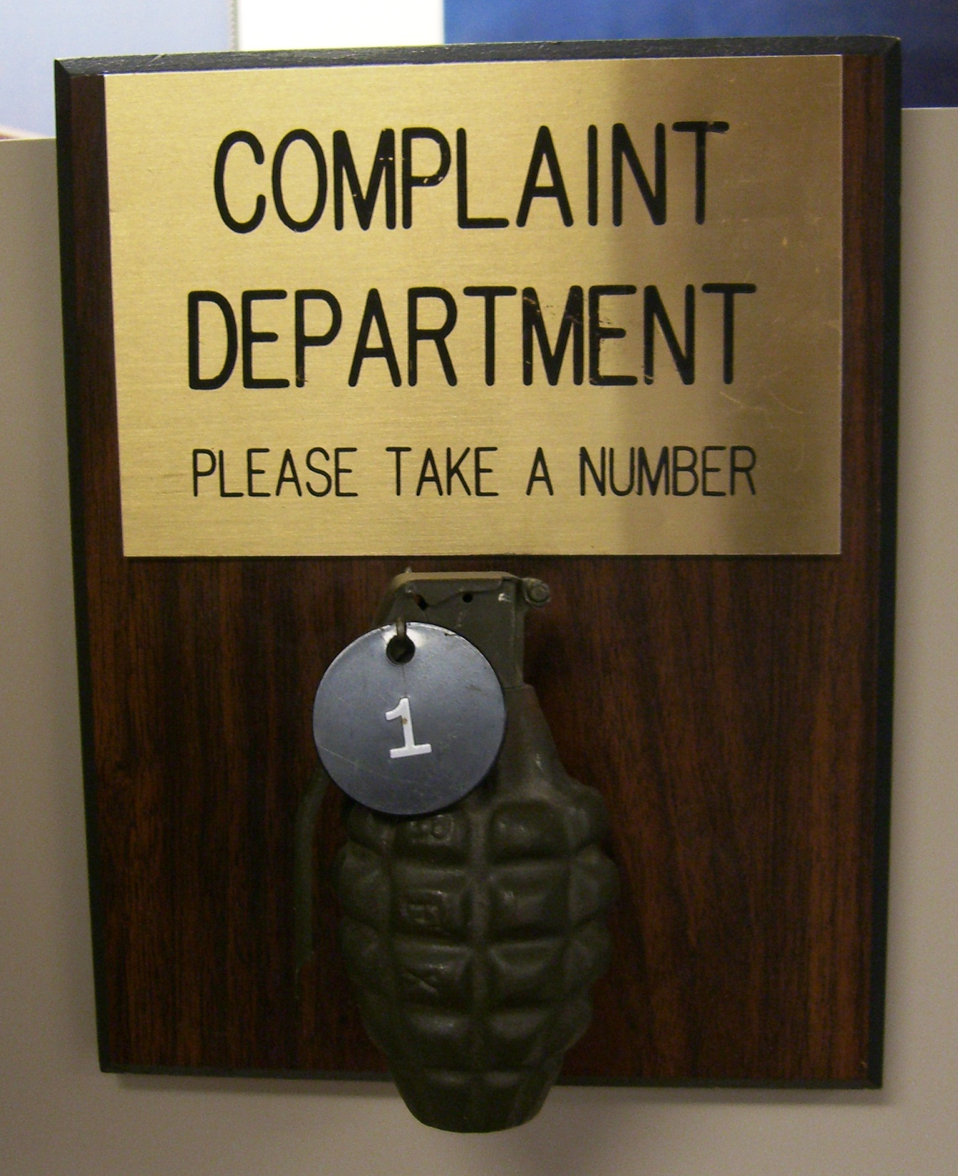

Slide 21
Think…
BREACH OF CONTRACT
&
DAMAGES

Slide 22
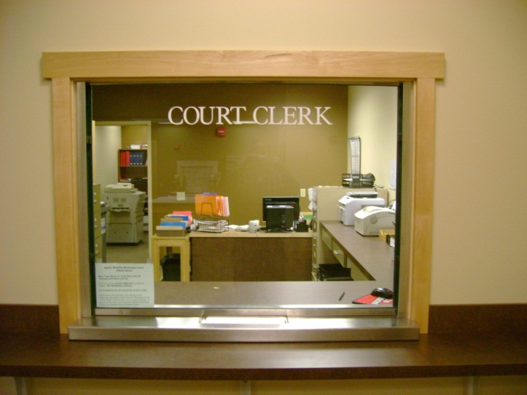

Slide 24
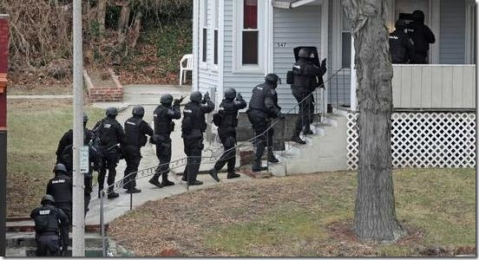

Slide 26
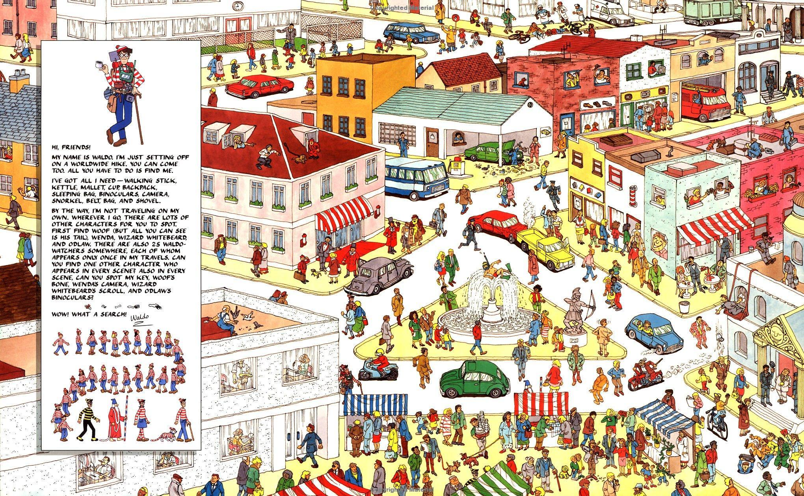

Slide 27
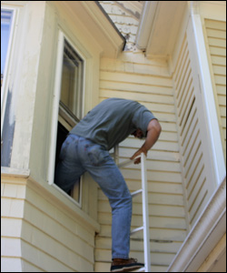

Slide 28
GOOD SERVICE TAKES TIME
There is no McService

Slide 29
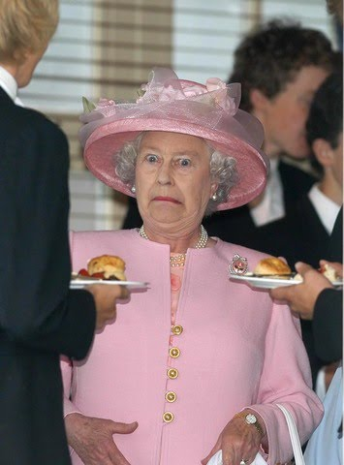

Slide 31
COMPLAINT
COUNTERCLAIM

Slide 32
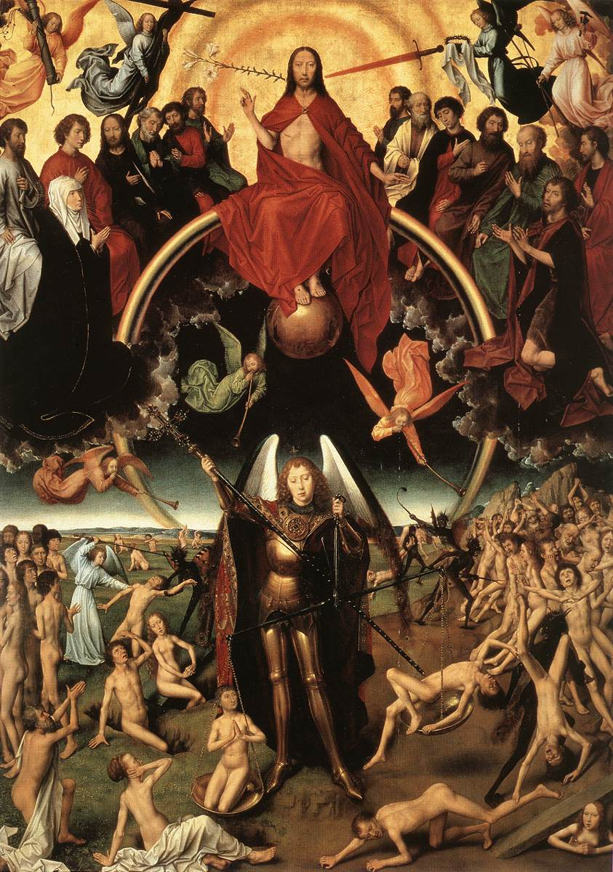

Slide 33
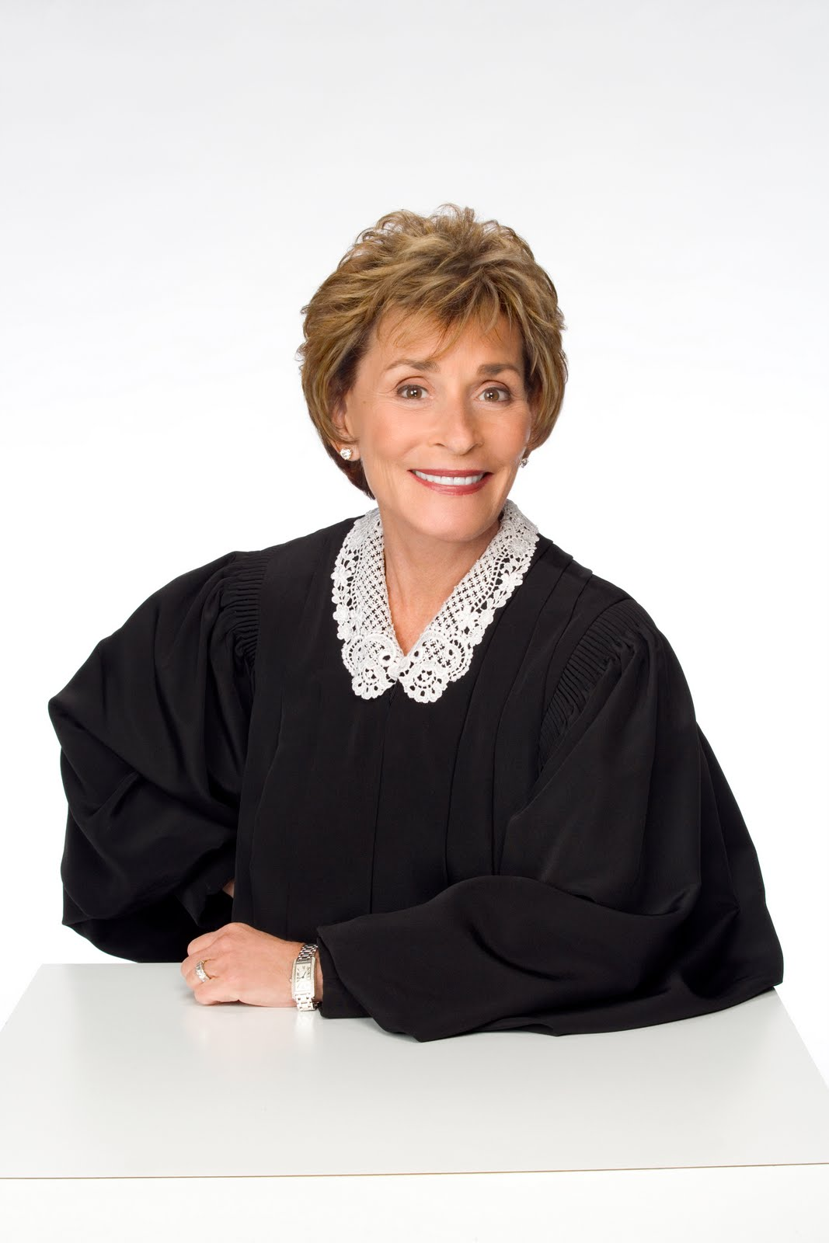

Slide 35
-ish

Slide 36
Not an actual sheriff

Slide 37
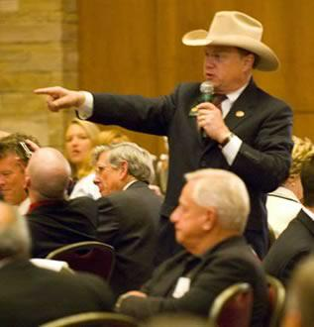
Actual Master Commissioner

Slide 41
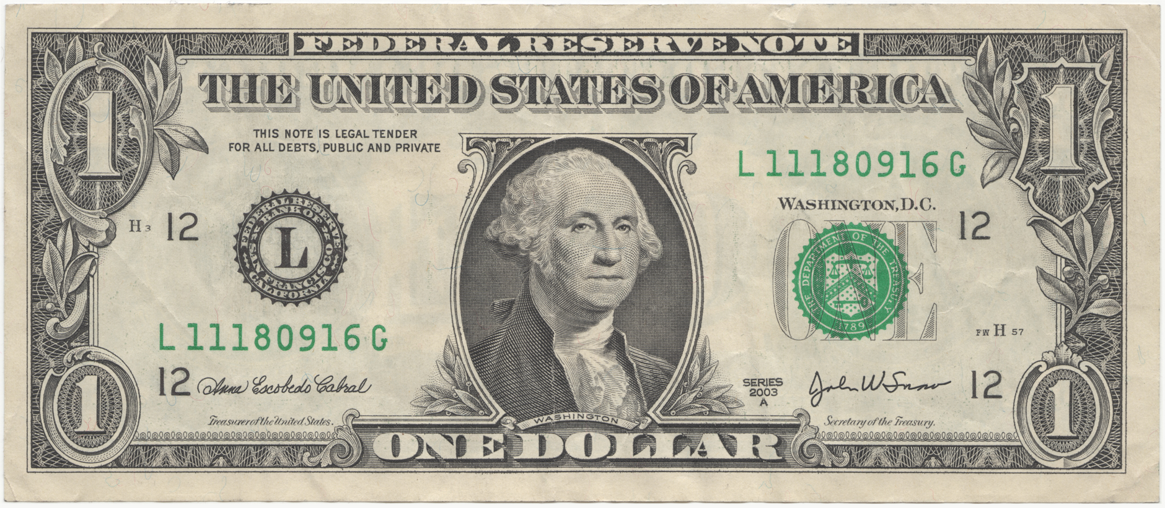

Slide 42
OOPS

Slide 43
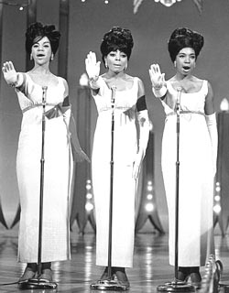

Slide 45
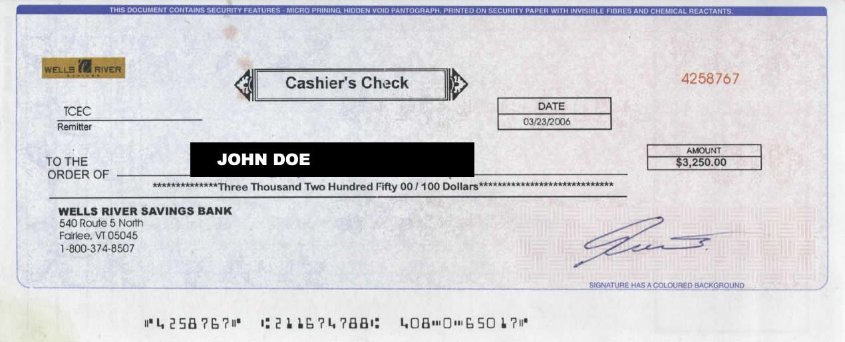

Slide 48
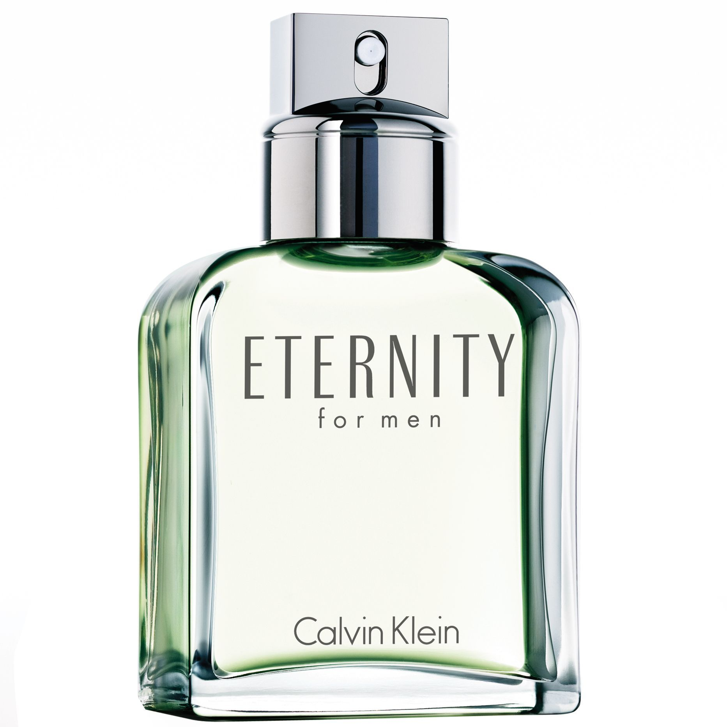

Slide 49
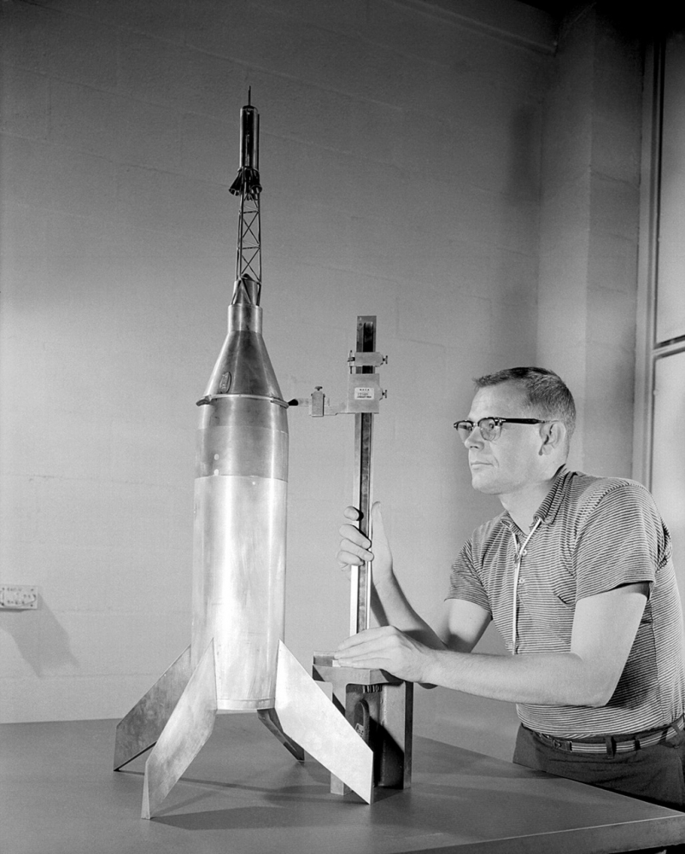

Slide 50
CAUTION: EXTREMELY DATED REFERENCE!!!!!

Slide 52
Now for non judicial
foreclosure…

Slide 54
No Judges Need Apply

Slide 55
Due Process Does NOT Apply

Slide 56
Actually it’s “Power of Sale”

Slide 57
Default Notice Sent.

Slide 58
Notice of Sale Prepared..
Posted at Courthouse.
Published in Local Paper.

Slide 59
First Base – First Legal

Slide 61
Sheriff’s Auction.

Slide 62
Sold…

Slide 63
Or…

Slide 64
Cancelled.

Slide 66
RESTART REQUIRED

