Slide 1

Title Basics

Slide 2
What’s in Title?
“Title” refers to ownership of an interest in real estate.
In a case where a Deed of Trust is used to secure a real estate loan, the title is divided into two components: legal title and equitable title.
    Legal Title provides that right of ownership but no beneficial interest in the property.
    Equitable Title is the right to possess and use the property.
    The Deed of Trust conveys legal title to the property to the trustee and grants the trustee the power of sale upon default by the trustor. The trustor retains equitable title to the property. Once the promissory note secured the Deed of Trust has been paid in full, the trustee will record a reconveyance to transfer legal title back to the trustor. If the trustor defaults on the loan, the beneficiary may exercise their right and instruct the trustee to conduct a trustee’s sale at which time the trustor’s equitable title will be transferred to the purchaser at the trustee’s sale.

Slide 3
Chain of Title
“Chain of title” is the history of conveyances and encumbrances affecting the title to a property. A chain of title is established when title to property is transferred from one person or entity to another. Usually, “chain of title” refers to the transfers of the property from one owner to the next. However, when a Deed of Trust is created, a chain of title may arise subsequent to that Deed of Trust when the beneficial interest of that Deed of Trust is transferred from one beneficiary to another. The chain of title to the foreclosing beneficiary is of special importance to the trustee conducting a foreclosure. The trustee must be sure that our foreclosing beneficiary is actually on title as the current beneficiary of the Deed of Trust.

Slide 4
Chain of Title to Current Owner
Builder
Owner Number 1
Owner Number 2 (Current Owner)

Slide 5
Chain of Title to Current Beneficiary
Deed of Trust is Recorded Naming Original Beneficiary
Assignment to Beneficiary Number 2
Assignment to Beneficiary Number 3 (Current Beneficiary)
Current Beneficiary Initiates Foreclosure

Slide 6
Evidence of Title
Title and the transferring of title to property is made known to the public through the recording of written documents with the county recorder. It is this source of public records that allows us to trace the chain of title.
The system of recording documents was developed to protect property owners’ rights. While the recording of deeds and other documents is not required by law, it serves to give the work constructive notice of the contents of the document. The general rule is “the first to record is the first in right”. In other words, if a person tried to sell a property to two different people at the same time, the first one to record his deed would be entitled to the property. There are some exceptions to this rule, but this illustrates the importance of recording documents.

Slide 7
Title “Transfer” Instruments
A deed is the document used to transfer ownership of real estate from one person to another. There are several types of deeds that may be used to transfer title.
    Grant Deed
    Quitclaim Deed
    Deed of Reconveyance
    Trustee’s Deed

Slide 8
Grant Deed
The grant deed is the most commonly used deed. The term Warranty Deed, which is not as common, is used synonymously. The grant deed carries two implied warranties (guarantees not expressed in the document). 1) that the grantor has not already conveyed title to any other person and 2) that the estate being conveyed is free from encumbrances made by the grantor or any other person claiming under the grantor, other than those disclosed to the grantee. The grant deed also conveys any after acquired title. This means that if the grantor receives an additional interest in the property after he grant deeds it to the grantee, that interest automatically passes to the grantee.

Slide 9
Quitclaim Deed
The quitclaim deed carries no implied warranties (guarantees). It simply conveys whatever interest the grantor has in the property, if any. The quitclaim deed is often used as a tool to remove matters of title from the record or clear up “clouds” on title.

Slide 10
Deed of Reconveyance
Deed recorded to transfer legal title from the trustee back to the trustor once the note secured by a Trust Deed has been paid in full.

Slide 11
Trustee’s Deed
Deed transferring title from the trustee to the purchaser at a trustee’s sale

Slide 12
Title Searches
Because the documents used to transfer title to real estate are recorded with the county recorder, the chain of title can be traced by doing a title search. These searches are usually done by title companies, who are experience in searching the public records. However, everyone has access to the records and anyone may conduct a search.
When purchasing a property, the buyer is entitled to receive “good and marketable” title. “Good and Marketable” title means that the chain of title can be traced through all previous owners back to the time when the property was originally transferred from the government. “Good and Marketable” title also indicates that title to the property is not subject to any defects or limitations except those specified in the contract of sale.

Slide 13
Title Searches – cont’d
The buyer will normally hire a title insurance company to search the public records and provide a preliminary title report. The preliminary title report shows the history of title to the property and all encumbrances and restrictions. The title company will then insure the buyer’s title based on the preliminary title report. The title insurance policy will insure the buyer against monetary losses in the event that his title to the property is lost or limited for a reason not known at the time the buyer acquired his title.
A trustee conducting a foreclosure also needs to be insured against losses that are a result of defects in title. A title insurance company will be hired to do a title search and provide a Trustee’s Sale Guarantee (TSG). The TSG provides mailing information for the current owners of the property as well as anyone else who is entitled to be noticed during the foreclosure. The TSG also lists all current encumbrances on the property. The title insurance company will insure the foreclosure based on the information provided in the TSG.

Slide 14
Defects in the Chain of Title and Remedies
Faulty or Missing Deeds
  Defects in the chain of title to the current owner of a property may be caused by faulty, missing or fraudulent deeds. A defect can occur anywhere in the chain of title and affect the title of the current owner. If any link in the chain of title is defective, then title may be defective from that point forward. Anything that is revealed by a title search that has the effect of preventing “good and marketable” title creates a “cloud” on title. Two remedies for removing a cloud on title are discussed below.

Slide 15
Remedies for removing a cloud on title
Quitclaim Deed
  The quitclaim deed was described previously and may be used to extinguish any partial or questionable interest in the property. A quitclaim deed says “I transfer any interest that I may have in the property”
Quiet Title Action
  A quiet title action is a court action to establish title to a property. A suit is brought in court to establish who holds title or the priority of lien

Slide 16
Priority of Liens
One issue that may affect a conducting a foreclosure is priority of liens. It is essential to know the priority of the liens against the property because the position of the deed being foreclosed will determine how the foreclosure is conducted. The priority of liens is established by the order of recording of the liens. Generally the first lien to be recorded has the first priority, followed by the second lien to record has the second priority, and so on. The priority of liens may be changed, however, by modifications or subordination agreements.

Slide 17
Conclusion of Basics…
Questions?

Slide 18

Thank You!

Slide 19


Slide 20

Post Origination Title Issues
  After Loan Origination
  Cannot be the subject of a title claim
  Manually cured, paid, negotiated or wait for the enforcement period to run

Slide 21


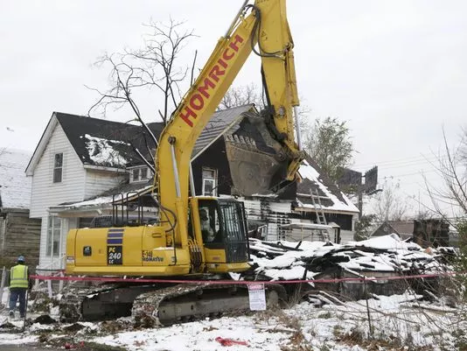
City Liens
Local, City, County Liens
  Trash removal
  Law mowing
  Demolition
  Sewer and Water

Slide 22

Pace Loans
Not Pace horses … Pace Loans

Slide 23
Property Assessed Clean Energy (PACE) is a means of financing energy efficiency upgrades or renewable energy installations for residential, commercial and industrial property owners.
More than 20 states have enacted legislation enabling the development of residential PACE programs, and residential PACE programs are operational in California, Florida and Missouri
Pace Loans attach to the property; not the person
Added to property taxes
Liens for PACE financing take priority over other lien-holders, and those lien-holders may not be notified or given an opportunity to object
Fannie Mae and Freddie Mac have refused to purchase or underwrite loans for properties with existing PACE-based tax assessments

Slide 24
State | Status | State | Status
Alaska | no current programs | Missouri | Available
Arkansas | Available in some locations | Nebraska | No current programs
California | Available in some locations | Nevada | No current programs
Colorado | Available | New Hampshire | C-Pace under development
Connecticut | Available | New Jersey | Under development
DC | Available | New Mexico | Under development
Florida | Available | New York | Available
Georgia | Under development | North Carolina | No current programs
Hawaii | On hold | Ohio | Available
Illinois | Under development | Oklahoma | No current programs
Kentucky | Under development | Oregon | Under development
Louisiana | Under development | Rhode Island | Available
Maryland | Available | Texas | Available
Massachusetts | Under development | Utah | Under development
Michigan | Available | Virginia | Available
Minnesota | Available | Wisconsin | Available
 |  | Wyoming | No current programs

Slide 25
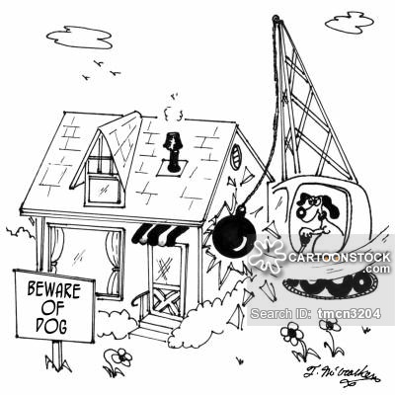
Code Violation - Demolition
Code Violations – contact city/county for details
Demolition liens
  Confirm status of property
  Lien attaches to the owner
    Pre-sale: review for write off
    Post sale: vacant lot and lien assessment

Slide 26

Federal Liens
Whenever a judgment is entered in U.S. District Court, it acts as a lien against property. In cases where a debtor owes any amount of restitution and/or a fine and special assessment equaling more than $2,500.00, The DOJ files a lien in the debtor's county of residence, and any other county where real estate is owned by the debtor.
The lien is in favor of the United States and includes its agencies, departments, commissions, boards, and other instrumentalities

Slide 27
Examples
  Judgments rendered in federal drug seizures or federal racketeering cases (e.g. Department of Justice Notice of Lien for Fine and/or Restitution Imposed Pursuant to the Anti-Terrorism and Effective Death Penalty Act of 1996)
  Judgments resulting from defaults on student loans guaranteed by the Federal Government
  Deficiency judgments in foreclosure cases on loans guaranteed by an entity of the Federal Government
  Judgments rendered on environmental suits by the Environmental Protection Agency

Slide 28
  The government is generally not willing to release its lien
  Liens can be subordinated by agreement or by the court
  Title companies will not insure foreclosures without a release or subordination of a Federal lien

Slide 29
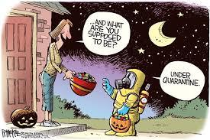
Quarantine Orders

Slide 30
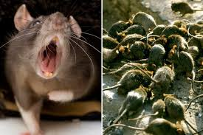
Quarantine Orders
Meth Labs
Mold
Communicable disease [Ebola]
Apple Maggots, Asian Longhorned Beetles,
Gypsy Moths
Rats, spiders and other infestational species

Slide 31
Sovereign Citizen & Militia Claims
Sovereign citizen groups are loose associations of antigovernment extremists who do not recognize the Federal Government. They believe they are separate or sovereign from the United States and are exempt from Federal, State, and local laws and tax systems. They believe the county sheriff is the supreme law enforcement officer in the land and county clerks or registrars are the only legitimate elected officials. They subscribe to a belief in “common law” and their right to arrest or sue employees of the “illegitimate government.”
Sovereign citizens have been investigated by HUD for not only illegally occupying HUD properties, but also improperly deeding HUD-owned properties to themselves. These groups take advantage of State laws in most States that require county clerks to accept and file any quit claim deed presented to them as long as the forms are properly signed and fees are paid. No proof of ownership is required. It becomes the burden of the true property owner to go to court and clear the title.

Slide 32
UCC Liens aka Fixture Filings
A filing on a fixture is simply a UCC Financing Statement, recorded with the Secretary of State or in the real estate records, which includes “fixtures” in the collateral description. This filing does not attach to real property; however the use of UCC liens can impair title because they are superior to the “fixture.”
To clear a UCC lien, the fixture can be removed or the lien can be sold and the fixture sold with the property
Generally enforceable for 5 years [unless otherwise stated] and may be re-filed 6 months prior to expiration
Manufactured Housing UCC liens are enforceable for 30 years

Slide 33

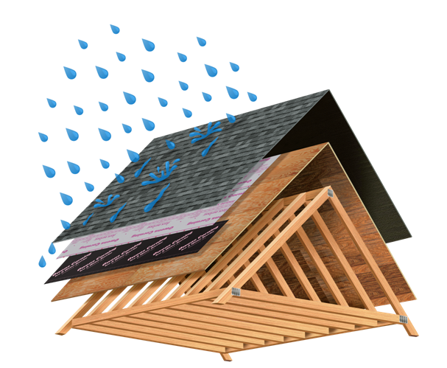



Slide 34
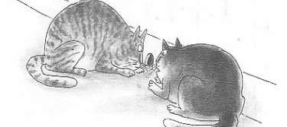
If WE WERE LAWYERS, THIS WOULD BE BILLABLE TIME

Slide 35
Eminent Domain and Condemnation
Condemnation, also called eminent domain or a “taking,” is the right of a government or its agent to take private property for public use, with payment of compensation. In a condemnation action, the government takes both physical possession and legal title to the property. A related legal theory, inverse condemnation, describes a situation in which the government does not take legal title but essentially regulates away all usefulness of the property.
Compensation refers to the amount that the government must pay a property owner for the condemnation of their property. This is typically measured in terms of loss to the owner, not the government’s gain. The amount of loss is measured according to the fair market value standards at the time of taking.

Slide 36
Condemnation and Foreclosure
During the foreclosure crisis several municipalities proposed using the power of eminent domain to condemn underwater mortgages. Homes with underwater mortgages—those with negative equity— are significantly more likely to enter foreclosure than homes with equity.
Under the Plan, the municipality would acquire the mortgage by paying the lender 20–25% below the fair market value of the home. Now the owner of the property, the municipality write down the principal balance owned to the home’s value
The homeowner, no longer underwater, could then refinance to receive lower interest rates and start to build equity in the home immediately
After lenders threatened to stop lending in these municipalities the proposals were not pursued

Slide 37

Federal and State
Criminal Forfeiture Actions
Criminal forfeiture is the taking of personal property or real estate by the state due to its relationship to criminal activity. Criminal forfeiture may be sought when the property is used in the commission of a criminal offense, or where the property was obtained through criminal activity.
Forfeiture laws vary from state to state, and may be broader or narrower depending upon the crime committed and the laws of the state or jurisdiction in which the crime is committed or in which the property is located.
No compensation is provided to the owner
“Innocent Owner” defense is available to mortgagees

Slide 38
Unlike a criminal case, the government must only show it is more likely than not that the lender knew or should have known of the illegal activity to prove the lender is not an “innocent owner.”
The knowledge of any officer of the lender will provide a basis of “knowledge” by the lender.
This showing of knowledge can be made by circumstantial evidence. Whether a lender should investigate the use of its collateral based on evidence it acquires will be a difficult question.

Slide 39
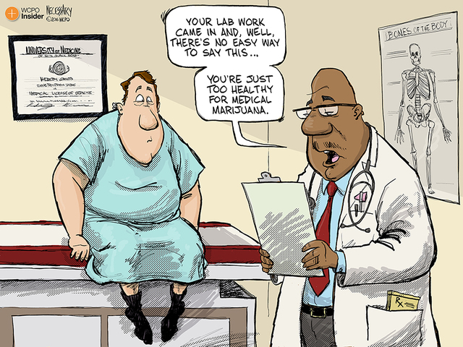
Marijuana

Slide 40
The particular problem of Mary Jane
As states legalize Marijuana, Lenders may lose the “innocent owner” defense
2009 Ogden Memo stated the DOJ would not likely pursue forfeitures and actions against cultivators of schedule I [marijuana] drugs and was further supported by the 2013 Cole Memo
Both have been reversed by the DOJ under Jeff Sessions
Generally, if the lender is not aware of the illegal activity before the loan was made and responded appropriately upon learning of the illegal activity, it will qualify as an “innocent owner.” The lender would then be entitled to receive what it is owed by the borrower up to the amount of the forfeiture sale proceeds, after deductions for costs and expenses. Unless there is a large amount of equity in the property, the sale after forfeiture is unlikely to yield enough money to repay the loan made by the lender against the collateral.

Slide 41

For example, suppose a borrower obtains a loan for the purpose of installing extensive ventilation and lighting equipment, and to qualify for the loan, the borrower lists ownership in a limited liability company named “Best Bud.”
Would this be enough to defeat the lender’s “innocent owner” claim in a civil forfeiture proceeding? Depending on the circumstances, it might. Another open question is whether a lender could be forced to disgorge loan payments received from a borrower the lender knew was engaged in illegal marijuana activity

Slide 42
Origination Title Issues
  Matters not resolved at origination
    Legal description issues
    Prior Liens/Judgments
    Chain of title issues
    Ownership Issues
  Matters created at loan origination
    Acknowledgement issues
    Legal description Issues

Slide 43
Legal Description Issues
Three types of legal descriptions:
  Metes and bounds
  Rectangular Survey
  Platted Descriptions

Slide 44
Metes and Bounds
Used primarily in the Eastern States
Completely describes the boundary lines of the land. Each boundary line or “call” is described by a course and a distance. The course is the direction in which the boundary line travels and the distance is the length of the boundary line.
A metes and bounds description must close. This means that the legal description starts at a beginning point, follows each boundary line by course and distance, and ends back at the beginning point. If the land description does not close, it is defective.

Slide 45
Metes and Bounds Example
IN THE SECOND CIVIL DISTRICT OF HAMILTON COUNTY, TENNESSEE: TO FIND THE TRUE POINT OF BEGINNING, COMMENCE AT A POINT LOCATED IN THE SOUTHERN LINE OF CLEMONS ROAD WHERE IT INTERSECTS THE NORTHWEST CORNER OF A 15 FOOT UTILITY EASEMENT AND THE NORTHWEST CORNER OF LOT FOUT (4), CHARLES LANKFORD'S SUBDIVISION, UNIT 2, AS SHOWN BY PLAT OF RECORD IN PLAT BOOK 41, PAGE 168, INTHE REGISTER'S OFFICE OF HAMILTON COUNTY, TENNESSEE; THENCE SOUTH 25 DEGREES 01 MINUTES WEST A DISTANCE OF 227.79 FEET TO A POINT; THENCE SOUTH 66 DEGREES 34 MINUTES EAST A DISTANCE OF 116.7 FEET TO A POINT LOCATED IN THE WESTERN LINE OF LOT 2, CHARLES E. LANKFORD'S SUBDIVISION, AS SHOWN BY PLAT OF RECORD IN PLAT BOOK 39, PGE 320; THEN SOUTH 23 DEGREES 26 MINUTES WEST A DISTANCE OF 24.54 FEET TO THE SOUTHWEST CORNER OF SAID LOT 2; THENCE POINT OF BEGINNING, THENCE ALONG THE SOUTHERN LINE OF SAID LOT 2, SOUTH 66 DEGREES 34 MINUTES EAST A DISTANCE OF 90.0 FEET TO THE SOUTHEAST CORNER OF SAID LOT 2; THENCE ALONG THE EASTERN LINE OF LOT 2, NORTH 23 DEGREES 26 MINUTES EAST A DISTANCE OF 52.24 FEET THE SOUTHWEST CORNER OF LOT 5, PAIRS SUBDIVISION, AS SHOWN BY PLAT BOOK 41, PAGE 168; THENCE WITH AND ALONG LOTS 5, 4, 3, 2, AND 1, PAIRS SUBDIVISION, AS SHOWN ON PLAT BOOK 41, PGE 168, SOUTH 66 DEGREES 34 MINUTES EAST A DISTANCE OF 335 FEET TO THE CENTERLINE OF SAID CREEK, SOUTH AND WEST A DISTANCE OF 544+/- FEET TO AN IRON PIN; THENCE NORTH 23 DEGREES 26 MINUTES EAST A DISTANCE OF 134.2 FEET, TO THE TRUE POINT OF BEGINNING.

Slide 46
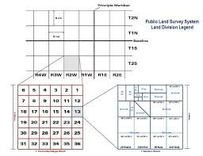
Rectangular survey examples

Slide 47
Example of Rectangular Survey
Legal Description
A part of SW ¼ of the SW ¼ and a part of the SE ¼ of the SW ¼ of Section 20, Township 14 North, Range 32 West, Washington County, Arkansas, and more particularly described as beginning at a point 295.0 feet, N 0 degrees 41’ 59” E of the SW corner of the SW ¼ of the SW ¼; thence N 89 degrees 56’ 04" W 730.02 feet; thence N 0 degrees 56' 39” E. 1036.42 feet; thence S 89 degrees 56’ 04” E. 726.0 feet to a stone of the NE corner of the SE ¼ of the SW ¼; thence S 87 degrees 12’ 32” E. 172.1 feet: thence S 0 degrees 41’ 59” W. 300.0 feet; thence S 87 degrees 12’ 32” E. 743.45 feet to the centerline of Cox Spring Branch; thence along said centerline S 36 degrees 38’ 42” E. 66.71 feet; thence S 42 degrees 19’ 58” W. 56.22 feet; thence S 0 degrees 38’ 26” W. 62.62 feet; thence S 28 degrees 47’ 37” E. 64.4 feet; thence S 21 degrees 27’ 11” W. 58.02 feet; thence S 23 degrees 57’ 16” W. 116.25 feet; thence S 3 degrees 08’ 02” W. 120.16 feet; thence S 22 degrees 11’ 26” E. 246.42 feet; thence leaving said centerline N 88 degrees 07’ 19” W. 975.6 feet to the point of beginning and subject to a power line easement, a 30 foot easement for egress, ingress and utilities being 15 feet of equal and uniform width each side of a centerline, said centerline described as beginning at a point 40.0 feet N 87 degrees 12’ 32” W. of the NE corner of the above described tract; thence along said easement centerline S 3 degrees 01’ 28” E. 273.16 feet; thence S 13 degrees 08’ 58” W. 162.51 feet; thence S 2 degrees 32’ 24” E. 247.65 feet; thence S. 38 degrees 39’ 2” E. 95.2 feet and ending in the centerline of Washington County Road #8 and any other easement of record.

Slide 48
Platted Legal Description
Lot 14, Block 1, Golden Meadows Subdivision to the City of Conway, Arkansas as shown on plat of record in Plat Book E, Page 91, Records of Faulkner County, Arkansas.

Slide 49
Issues with Legal Descriptions
legal description of property that is legally sufficient to be binding, meaning that the description would allow a competent surveyor to delineate the exact boundaries of the property.
  Typographical errors can be resolved with Scrivener’s Affidavits in most states
  Vague descriptions may need to reformed with a judicial action. The following has been found to be “patently ambiguous” and not enforceable:
    “Thence with the Whitehead line. Thence straight to road that goes by Plainfield Church and with the road to the church to include 25 acres in all.“
  Incorrect legal descriptions will need to be reformed

Slide 50
Prior Liens/Judgments and Mortgages
Usually but not released of record; unless it is a Line of credit mortgage
Title Claim can be provide an indemnity; but GSEs, FHA and VA are reluctant to accept an indemnity and require “clear title”
If an indemnity is not acceptable, and a release is required, be very careful.
  Place the title company on notice
  If the prior lienholder cannot be located, a declaratory action may be necessary. In a judicial state a count can be added or the complaint amended in a non judicial states, the action would be separate from the non-judicial foreclosure

Slide 51
Ownership Issues
Marital Interests: Divorce does not always divest a party of ownership
Death: If no probate order determines heirship; heirs in the chain of title should be identified with affidavits from disinterested parties
Failure of title:

Slide 52
Acknowledgment Issues
Acknowledgments are required to validate a mortgage, deed or other document conveying real estate. Many states have specific forms.
Defective Acknowledgments can invalidate a document; which became a hotbed issue for Bankruptcy Trustees.
Many states have enacted remedial legislation to “cure defective acknowledgments

Slide 53
Defective acknowledgment
Property is owned by Casey and Shawn Wilson
The mortgage is purportedly granted by Casey and Shawn Wilson

Slide 54
Acknowledgment

Slide 55
How to Resolve and Manage Title Issues
Title claims are the most popular way to resolve title issues
A title claim can be provide an indemnity; but GSEs, FHA and VA are reluctant to accept an indemnity and require “clear title”
If an indemnity is not acceptable, and an actual resolution is required, exercise caution.
  Place the title company on notice
  If the prior lienholder cannot be located, a declaratory action may be necessary. In a judicial state a count can be added or the complaint amended in a non judicial states, the action would be separate from the non-judicial foreclosure

Slide 56
Resolving Issues Outside of a Title Claim
Due to the delays involved with title claims and investor refusal to accept indemnities, it is often beneficial to consider self-help approaches to resolve title issues.
  Looking to other parties to assist in resolving issues
    Closing agents
    Preparers of deed
    Notaries
  File corrective documents; affidavits, corrected deeds of trust; deeds; subordination agreements

Slide 57
Managing Outside Counsel
When a title company determines that an issue requires correction by an attorney, the title company will retain outside counsel.
  Role of outside counsel. Outside counsel is retained by the title company to represent the insured lender. The client is the lender, but outside counsel has involvement in strategy and settlement. Outside counsel also reports all information to the title company unless express request is made for confidentiality. Outside counsel owes a duty of loyalty to the insured lender, but the relationship is delicate and outside the normal attorney/client relationship.
  Techniques for improving timelines. While outside counsel must represent the best interests of the insured lender, timelines in the minds of outside counsel are much different than those of the insured lender. It is important to notify outside counsel of any key deadlines such as first legal action dates. While they have no obligation to meet these deadlines, most will try to accommodate as much as possible. It is also important to follow up with outside counsel regularly to ensure that the file is being worked.
  Ensuring accuracy of pleadings. Outside counsel often does not understand plaintiff names, investor relationships, securitized trusts, or other intricacies of mortgage servicing. These are often litigators which some real estate knowledge, but they sometimes use incorrect language in pleadings or incorrect plaintiff names. It is important that the foreclosure attorney review these pleadings to ensure accuracy of language. However, it is not uncommon for outside counsel to file complaints without consulting the title curative attorney so follow-up is key. It is also important to establish a good relationship with outside counsel so that expectations are understood.
  .

Slide 58
Managing Outside Counsel
  Appropriate timeframes for follow-up. Follow-up is critical with outside counsel to maintain timelines and ensure that all parties are fully informed. However, it is important to understand that judicial actions do take time to complete and be mindful that some courts move faster than others. Foreclosure counsel should have an understanding of timeframes required for certain activities and should follow up accordingly, but at a minimum of once a month. As a general rule, we follow up every two weeks.
  Judicial foreclosures completed by outside counsel. Some outside counsel may need to file a foreclosure action to clear the issue or may offer to include a count as a courtesy. While including a foreclosure count can be more time and cost efficient, it is important to consider that outside counsel is not bound to meet investor or servicer requirements and may not foreclose according to guidelines that are required of foreclosure counsel. We discourage including a foreclosure count unless absolutely necessary to prevent these issues

Slide 59
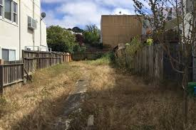
Post Sale Title Issues
  Legal Description
  Access Issues
  Encroachment

Slide 60
Utilizing Loss Mitigation to
Cure Title Issues
  Issues that can be resolved in conjunction with loss mitigation
    Erroneous releases. If the security instrument has been released in error, the borrower can execute an agreement to reinstate the security instrument.
    Legal description issues. If the security instrument describes the incorrect property, the borrower can execute documents to correct the legal description.
    Chain of title Issues. If there is an interest rights issue with the vesting deed, the borrower may be able to obtain proof of heirship. If the issue is that a party vested in title did not sign the security instrument, the borrower may be able to assist in getting that party to sign corrective documents.

Slide 61
Questions?

Slide 62
Thank You!

