Slide 1

Training Introduction:
What to expect with DXG

Slide 2

To be successful, we need to know what our goals are.
“Aren’t we all striving to be overpaid for what we do?”
– Will Ferrell

Slide 3
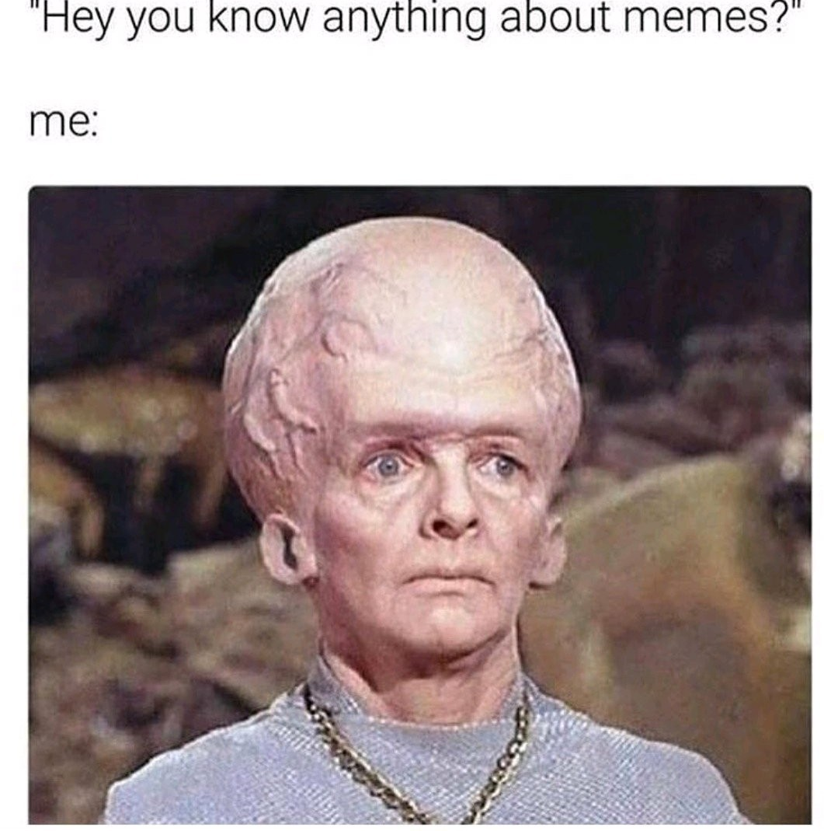
Expect to gain knowledge.
We WANT to provide you with valuable information!
We meme it!

Slide 4

Participation is encouraged.
Participation is bribed.
Participation is cajoled.
THAT ROCKS ARE INTERESTING

Slide 5

Don’t expect to get a nap.

Slide 6
Our goal is to have fun with this along the way….but,
Foreclosures are serious business, and the work we do affects the real lives of very real people.
We are all serious lawyers.
And you are serious professionals.
And we all respect the work we do and the homeowners involved.
None of our humor is ever intended to take away from the seriousness of the work we do.

Slide 7

Roadmap: Where are we going?
You are here.
You are going here.

Slide 8

We are going to drive on the ever changing roads of servicing. We will see the trails we have blazed before, and we will turn on to newly built, but maybe not completed, highways.

Slide 9


We will encounter roadblocks, potholes, and angry drivers, such as:
Compliance Challenges
Property Preservation Issues
Everything to do with New Jersey!
FYI: Not this New Jersey
Not this one either.

Slide 10
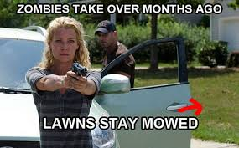
We may find ourselves using our best defensive driving skills with such obstacles as:
eNotes/eMortgages
Regulatory Change
New Servicing Rules
Title Issues
Successors In Interest
Bankruptcy Issues
Post Sale Litigation
And Zombie Properties
*queue The Walking Dead Meme:

Slide 11

We will meet old friends along the way.
CFPB
AGs & DoBs
HOAs, COAs, and VPRs in REO
FDCPA
QWRs

Slide 12

But no matter the challenge, we are here to guide you along the way.
Follow me, guys!

Slide 13

This is the end of the introduction, but just the beginning of our DXG journey.
And to quote modern day philosopher and life coach,
Ariana Grande…
THANK YOU! (Next.)

