Slide 1

Escrow 102 What happens in Years 2, 3, 4, 5?

Slide 2
Escrow Analyses During the Case
Section (f)(5) of Regulation X requires the servicer to provide the borrower with notice of any shortage or deficiency in the escrow account on at least an annual basis
Therefore, any exception or exemption from having to provide an annual escrow statement, such as where the loan is delinquent or the borrower is in a bankruptcy case, does not excuse the servicer from having to provide notice of an escrow shortage or deficiency on at least an annual basis
The Regulation also provides that if a servicer advances funds for a borrower, then the servicer must perform an escrow account analysis before seeking repayment of the deficiency

Slide 3
Post-Petition Escrow Accounting
The post petition ongoing payments received during the bankruptcy should be applied to the first payment due post petition, with the proper escrow component shown in the analysis.
The escrow calculation is done on a post petition basis- NOT a contractual basis.
That requires the first payment due after the date of filing is the starting date of the subsequent analysis, with the payments being applied as delineated in the escrow statements and Form B410A as to principal and Interest and escrow

Slide 4
Post-Petition Escrow Accounting
Once the debtor's chapter 13 plan is confirmed in a case involving the cure of a long-term mortgage debt, the creditor’s claim is split into two claims - the underlying debt and the arrearages
The debtor's ongoing postpetition mortgage payments must be applied from the petition date to the underlying debt based on the mortgage contract terms and original loan amortization as if no default exists

Slide 5
Post-Petition Escrow Accounting
This separate accounting for pre- and postpetition payments is consistent with industry standards
Under the topic of “Processing Pre-Petition and Post-Petition Payments,” the Fannie Mae Servicing Guide states: “The servicer must monitor and separately account for all pre-petition and post-petition payments”
Once a Chapter 13 bankruptcy plan has been confirmed, the Fannie Mae Servicing Guide states the servicer must “continue to monitor the timely receipt of all payments for the pre-petition arrearages and any post-petition payments that come due”

Slide 6
Post-Petition Escrow Accounting
This same bankruptcy accounting applies to the treatment of escrow accounts
The portion of each postpetition mortgage payment that is attributable to escrow must be applied as if no default exists
This means that the monthly postpetition escrow payments must be applied as deposits to the escrow account in accordance with the escrow account analysis prepared as of the petition date, and all subsequent postpetition analyses done during the case
The escrow portion of postpetition payments must not be applied to any prepetition escrow deficiency or shortage, as this is being paid separately as part of the prepetition arrearage

Slide 7
Post-Petition Escrow Accounting
The failure of a servicer to manage escrow accounts in accordance with industry practice and the Bankruptcy Code can have a devastating impact on debtors in Chapter 13 cases
By misapplying postpetition payments, a debtor’s escrow account will be either underfunded or overfunded, depending upon the circumstances
If the escrow account is overfunded, the debtor is asked to deposit more than is required, and this may cause postpetition defaults and unnecessary dismissal of the Chapter 13 case

Slide 8
Post-Petition Escrow Accounting
If the escrow account is underfunded and the error is not discovered until the end of the plan, it may not be feasible for the plan to be amended so as to bring the account fully current
Even worse, debtors may complete their plans believing that they are fully current, only to receive notice of an escrow deficiency once the bankruptcy case is closed

Slide 9
Post-Petition Escrow Accounting
Chapter 13 trustees around the country are beginning to look at how payments and escrow deposits have been applied when a notice of mortgage payment change is filed
If the escrow payment in the escrow activity or historical portion of the new escrow analysis does not match the analysis attached to the PoC or previous payment change notice, expect an inquiry or objection

Slide 10
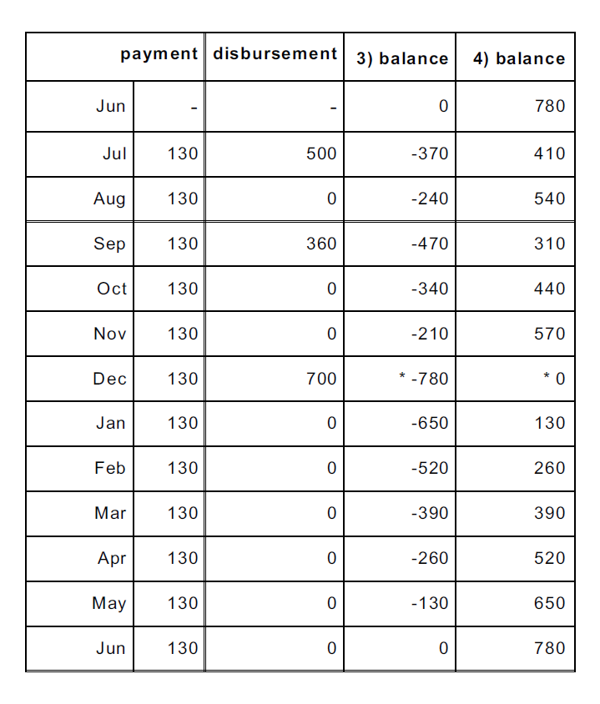
Escrow Analysis for the PoC

Slide 11
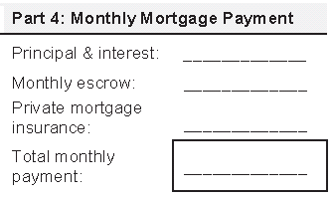
Revised Proof of Claim Forms
Form 410A – Part 4
Monthly Mortgage Payment:
The Total Monthly Payment is the sum of the principal and interest, monthly escrow, PMI, and other amounts (e.g., credit life insurance)
According to our analysis, the monthly escrow payment is $130
$130

Slide 12
Post-Petition Escrow Accounting
Assuming the servicer receives 12 payments in the next escrow computation period, there should be no escrow shortage on the subsequent analysis unless there is an increase in the amount of anticipated disbursements
If there is a true post-petition escrow shortage, the servicer can raise the mortgage payment as allowed under RESPA to recoup the shortage. See Hosley v. Wells Fargo Bank Minnesota, 2008 WL 516953 (N.D.N.Y. 2008)

Slide 13
Post-Petition Escrow Accounting
What to Look For:
On the historical portion of the Year 2 Escrow Analysis, the Actual Starting Balance in the Historical Portion of the Escrow Analysis should be the Actual Balance in the Escrow Account on the day the case was filed
The amounts for the monthly escrow deposit should be the amount of the monthly escrow deposit in Part 4 of Form 410A on the PoC
The start of the escrow computation period should be the same each year

Slide 14
Payment Change Notices
What to Look For:
Unless the loan has been transferred, the loan number and claim number should match the PoC and any prior payment change notices filed in the case
In Year 2:
The “Current Escrow Payment” should be the same as the “Monthly Escrow” in Part 4 of Form 410A from the PoC
In Years 3, 4, and 5:
The “Current Escrow Payment” should be the same as the “New Escrow Payment” from the Payment Change Notice filed the previous year

Slide 15
Questions?

Slide 16
THANK YOU

