Slide 1

Foreclosure 101 - Intro

Slide 2

Judicial
Foreclosure

Slide 3

Judicial Foreclosure in under 5 minutes

Slide 4


Slide 5


Slide 6


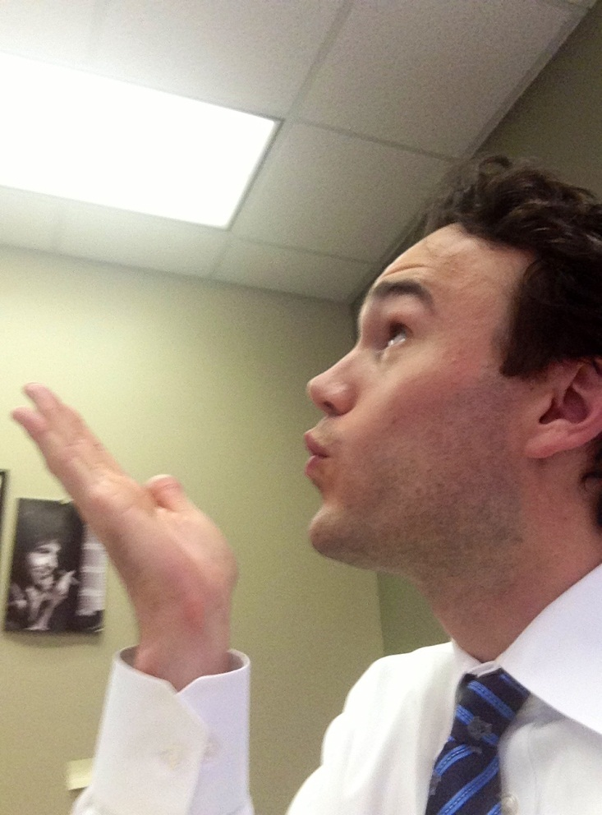

Slide 7
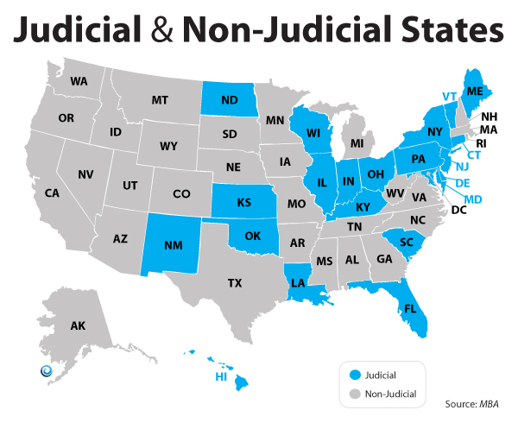

Slide 8
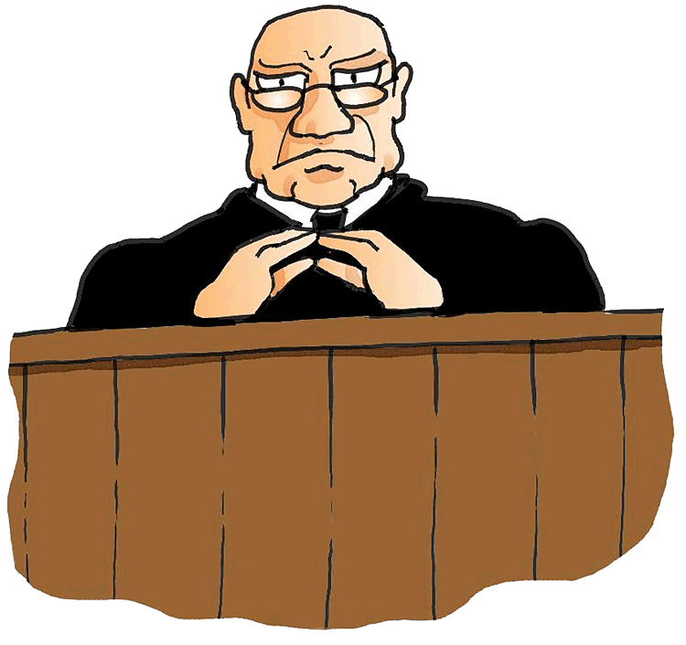
This may seem obvious

Slide 9


Slide 10


Slide 11

MY ACTUAL BABY
MY ACTUAL CHILDREN

Slide 12


Slide 13
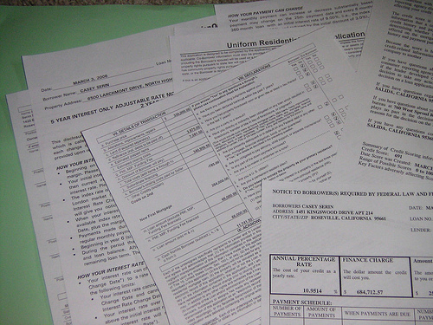

Slide 14
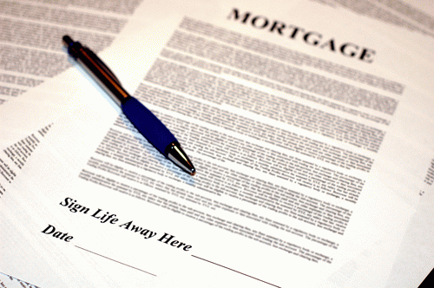

Slide 15
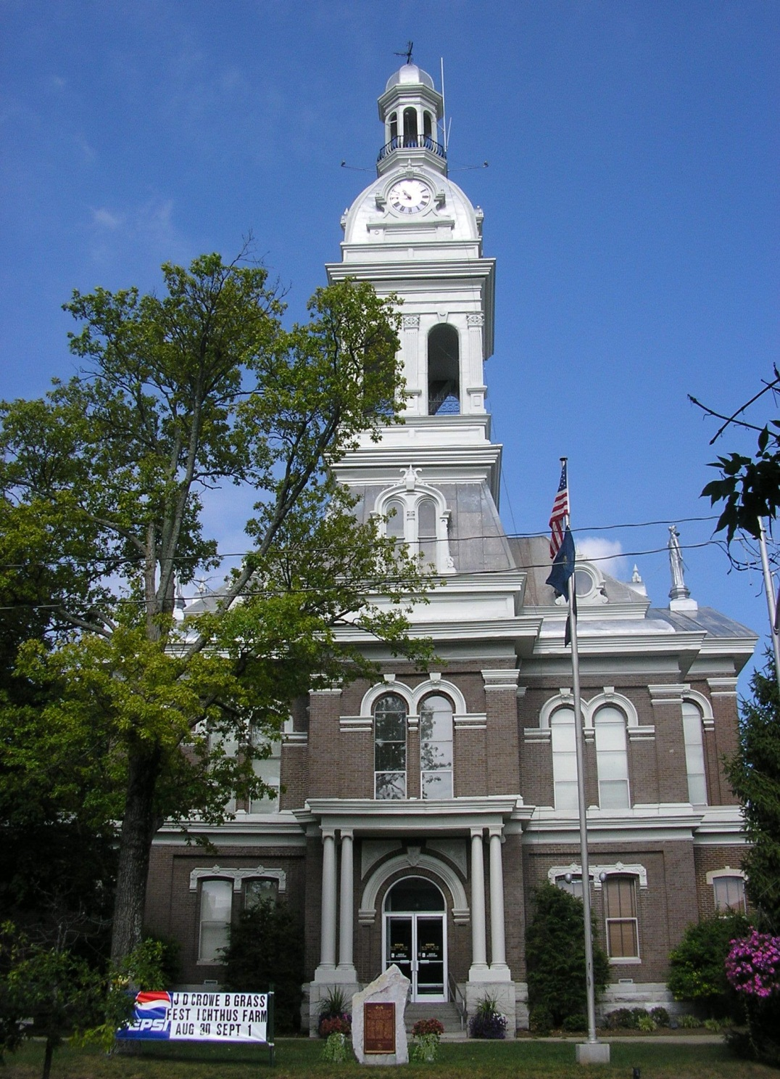

Slide 16
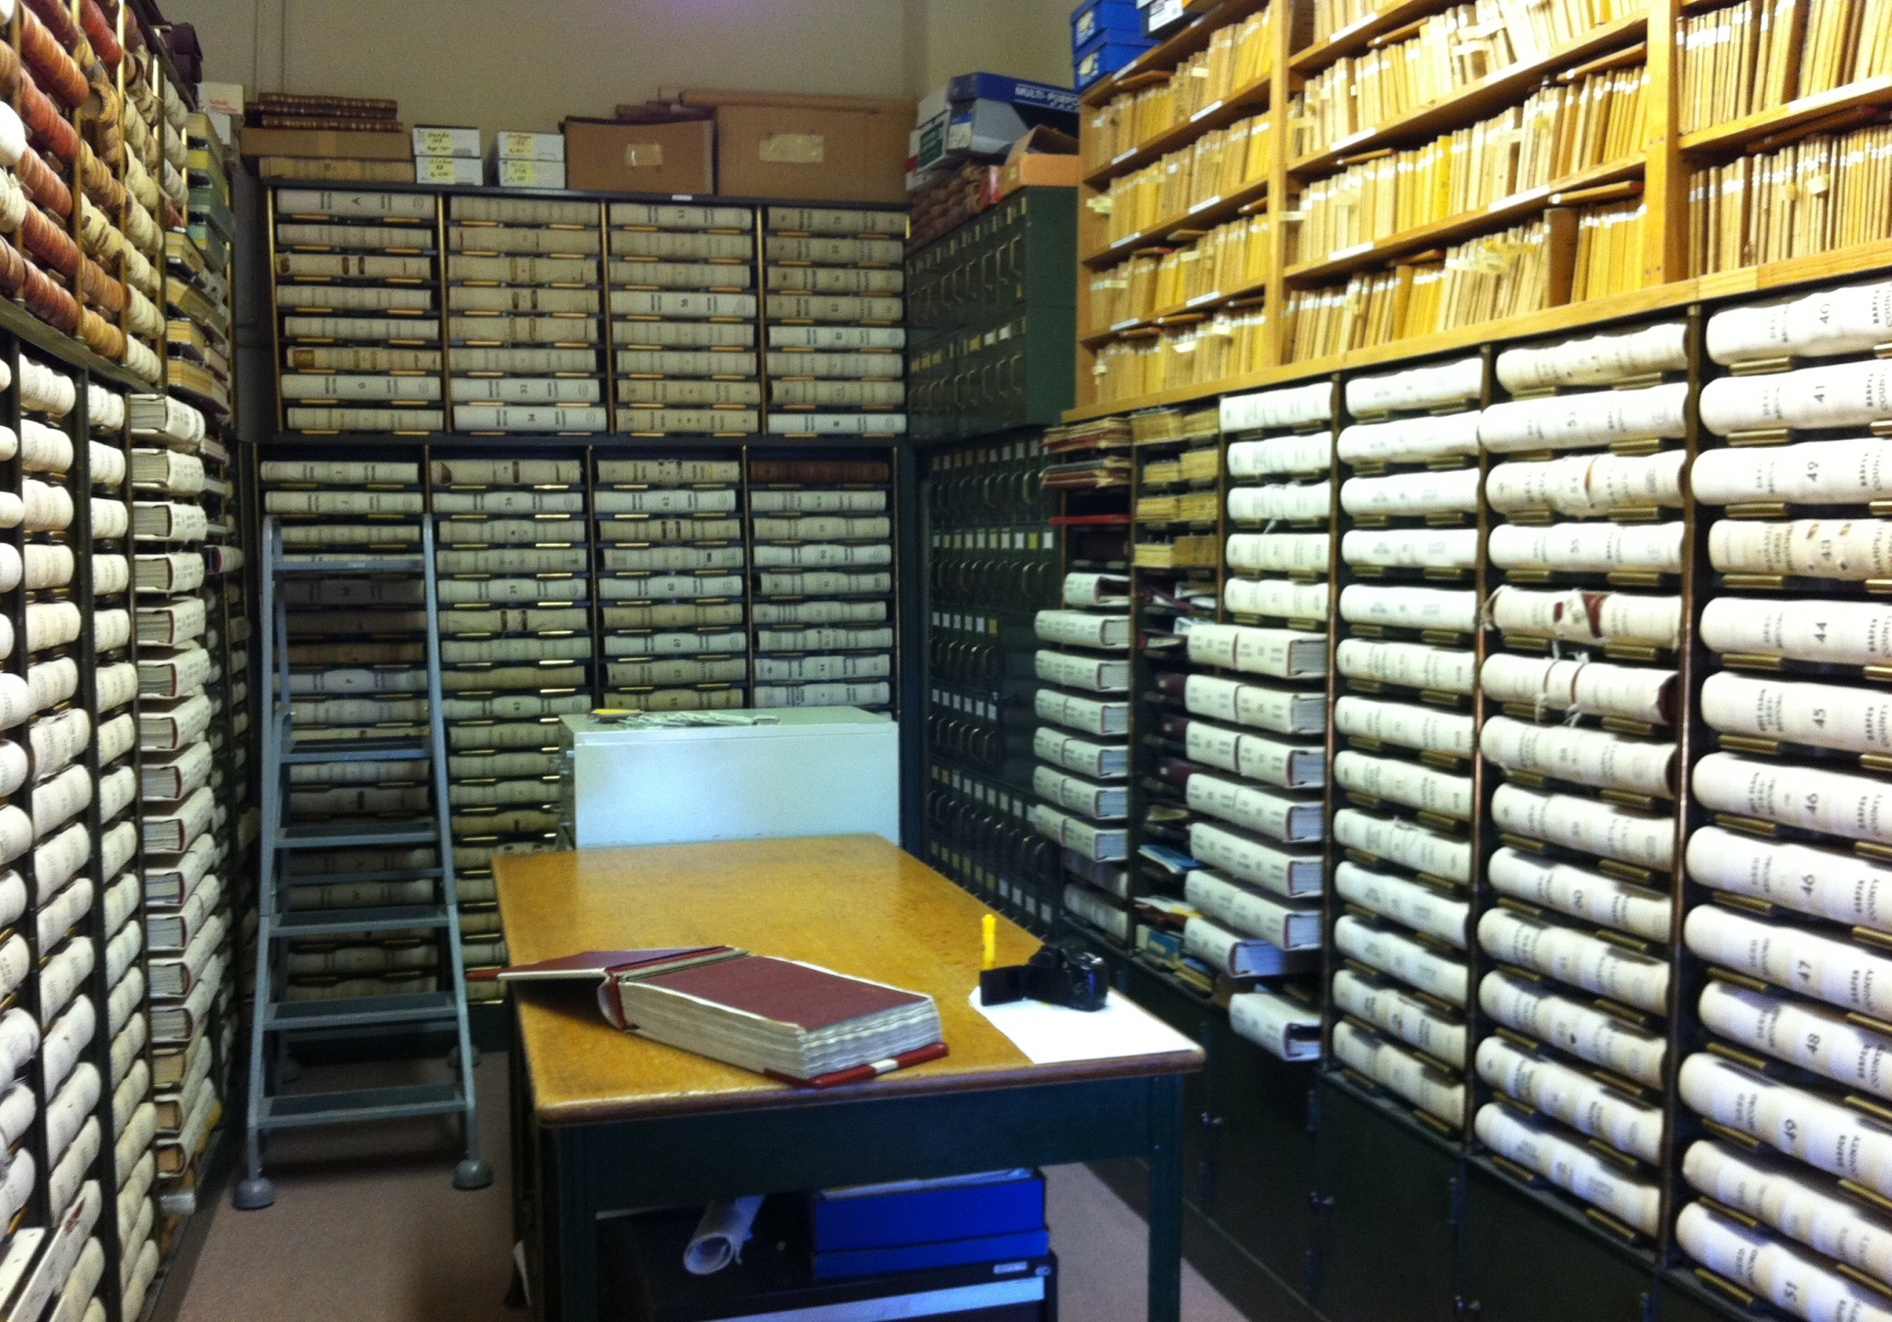

Slide 17

(Actual County Clerk)

Slide 18
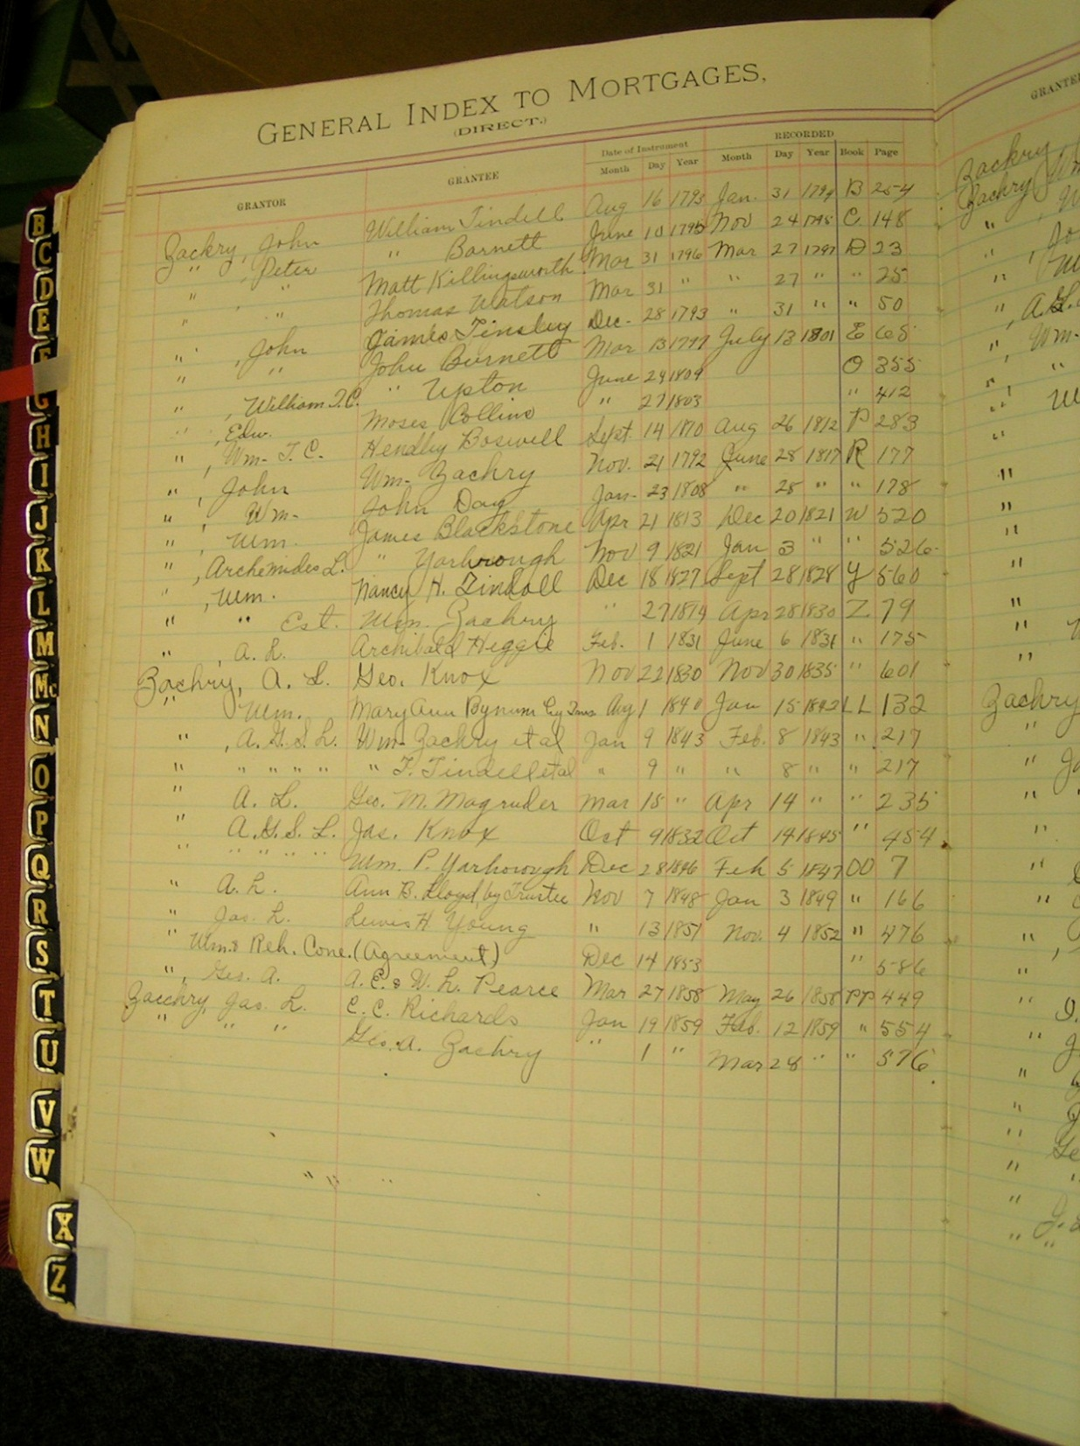

Slide 19


Slide 20
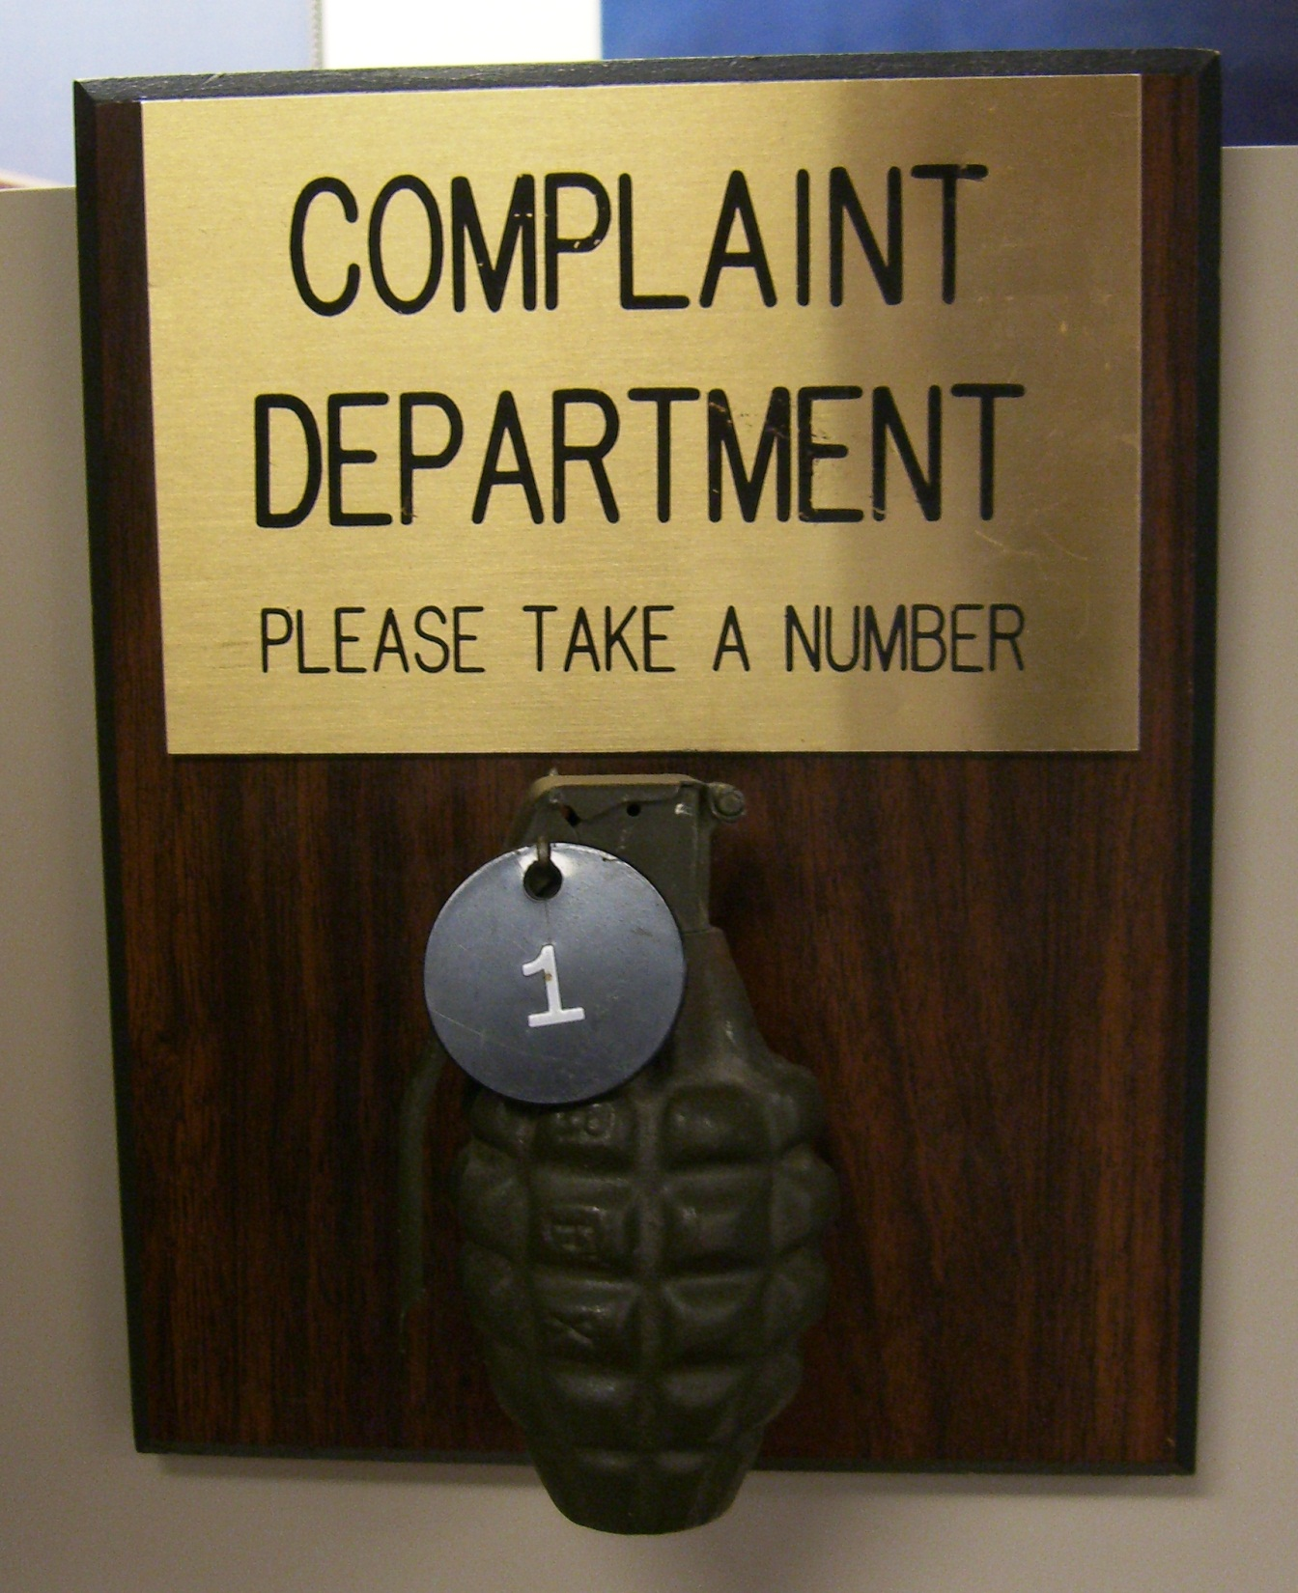

Slide 21
Think…
BREACH OF CONTRACT
&
DAMAGES

Slide 22
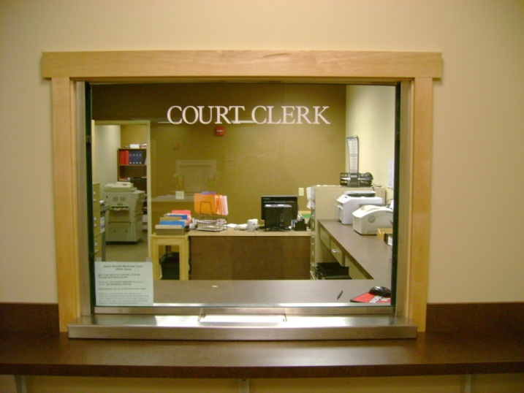

Slide 23
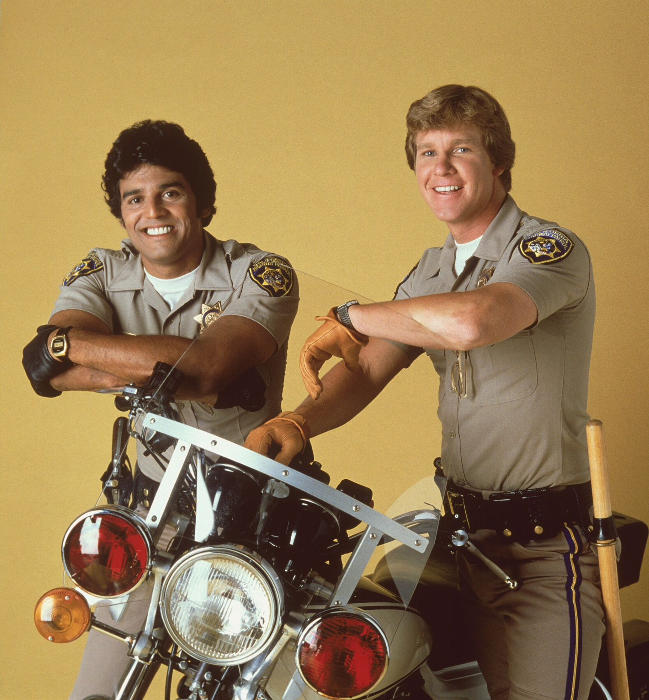

Slide 24
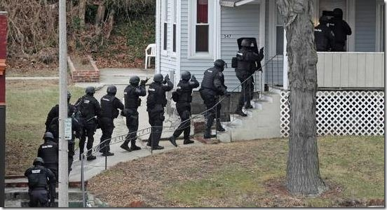

Slide 25


Slide 26
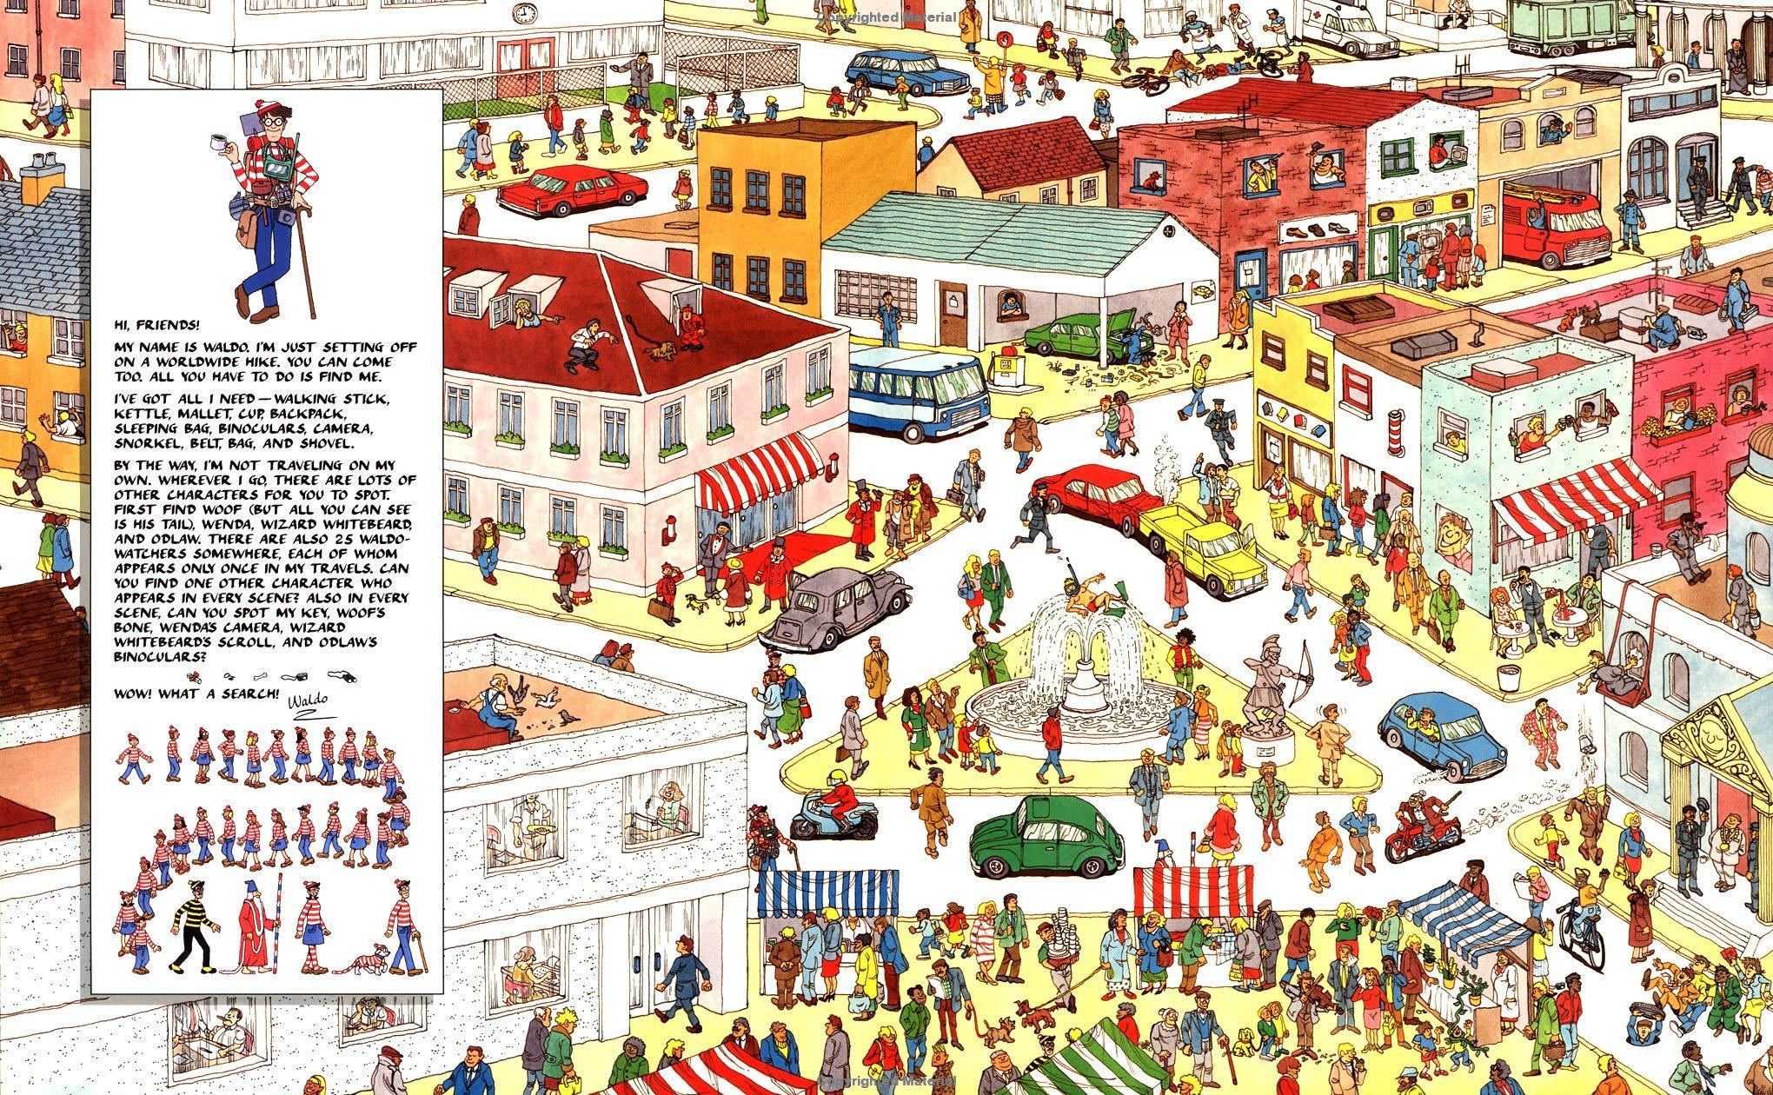

Slide 27
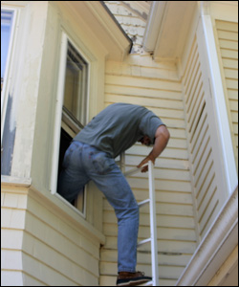

Slide 28

GOOD SERVICE TAKES TIME
There is no McService

Slide 29
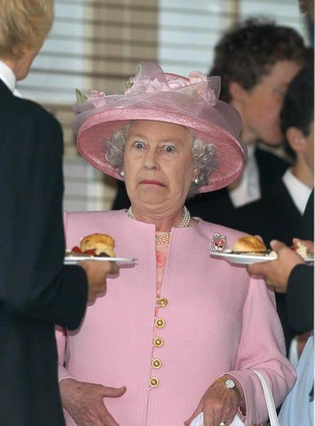

Slide 30


Slide 31

COMPLAINT
COUNTERCLAIM

Slide 32
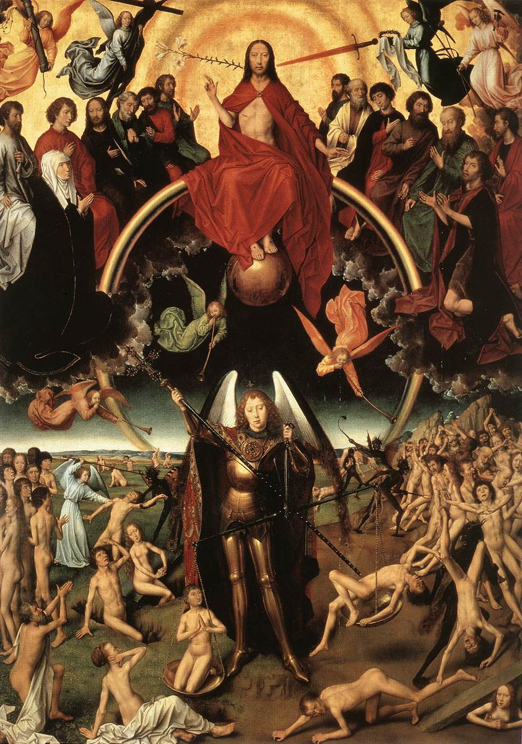

Slide 33
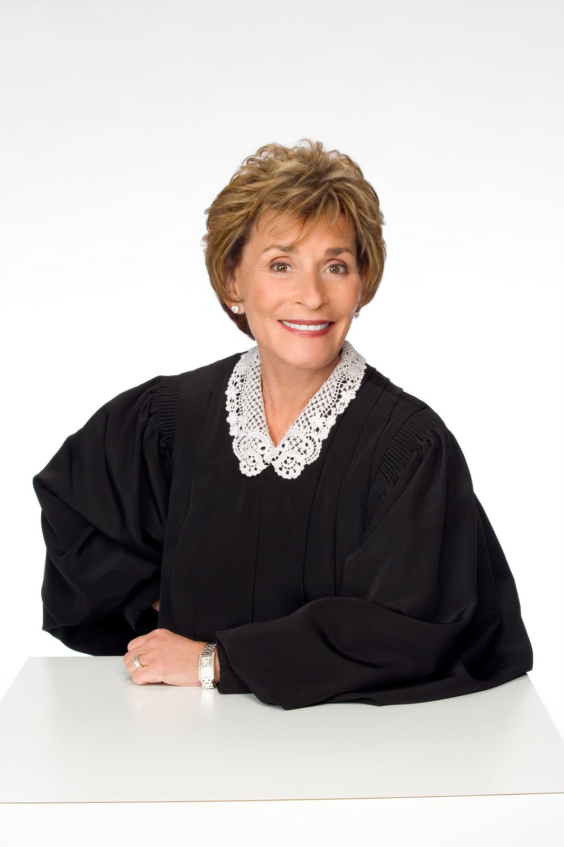

Slide 34


Slide 35

-ish

Slide 36

Not an actual sheriff

Slide 37
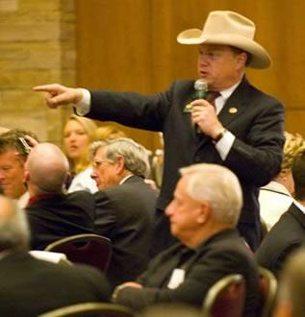
Actual Master Commissioner

Slide 38


Slide 39


Slide 40


Slide 41
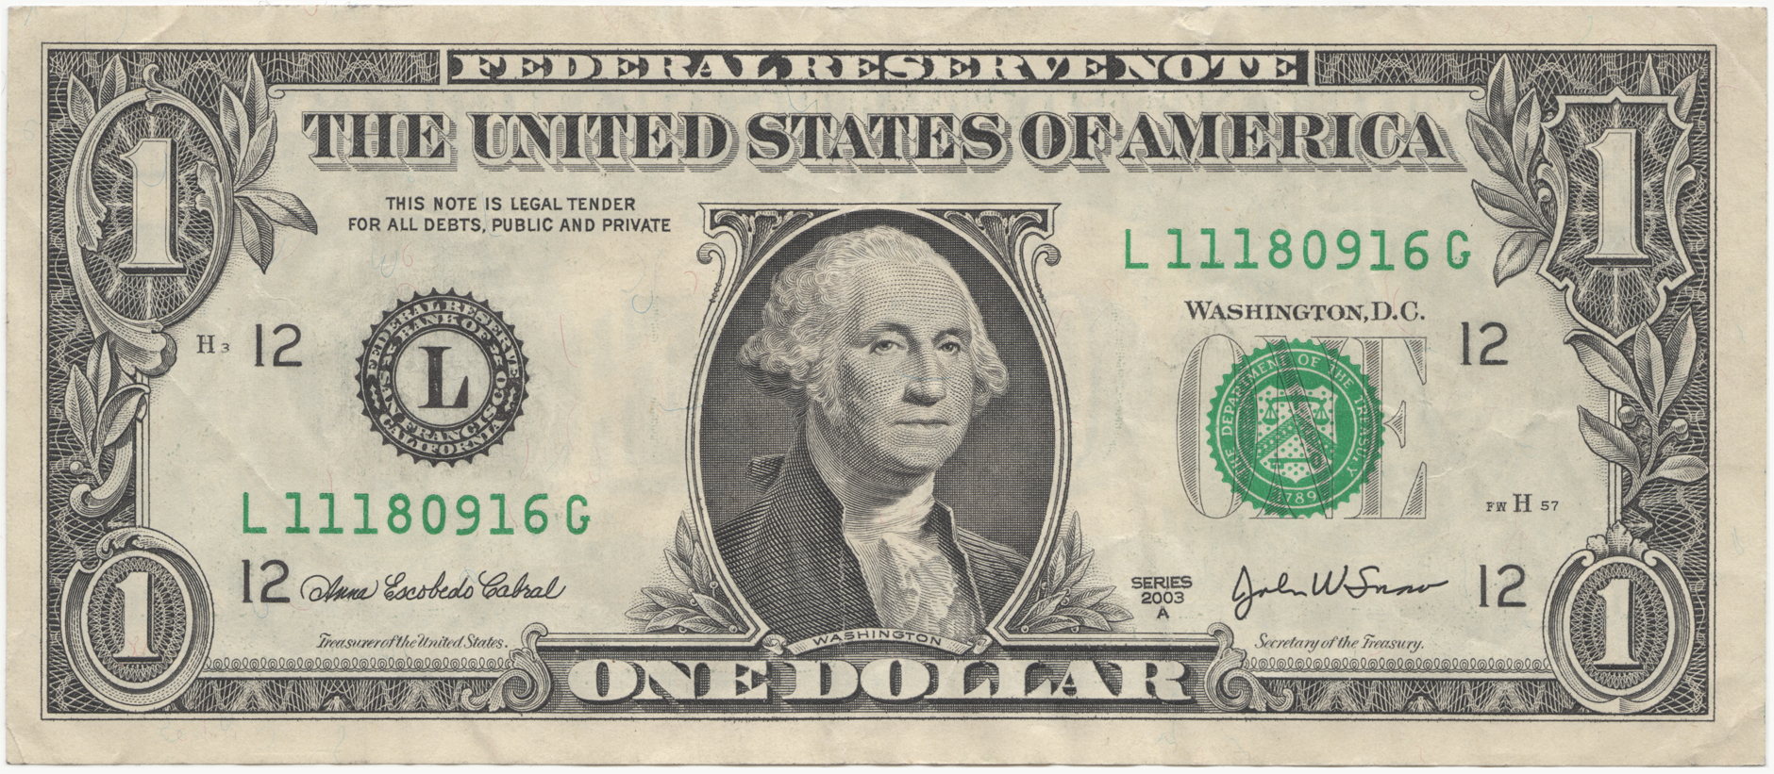

Slide 42

OOPS

Slide 43
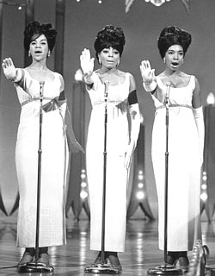


Slide 44


Slide 45
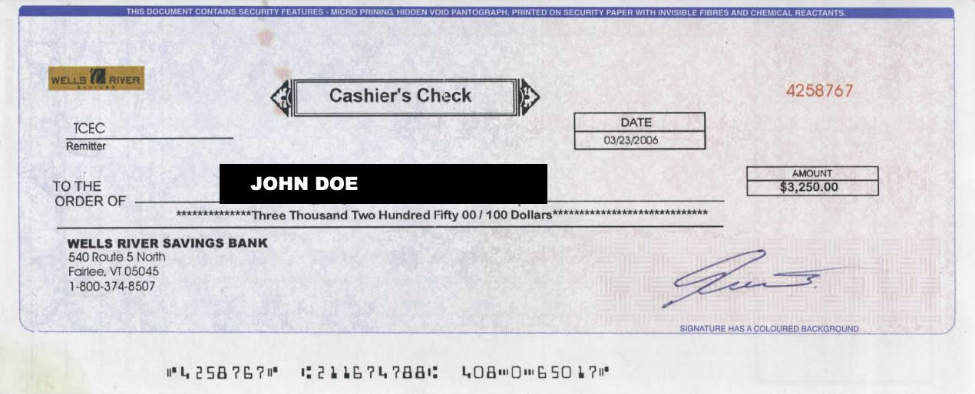


Slide 46


Slide 47


Slide 48
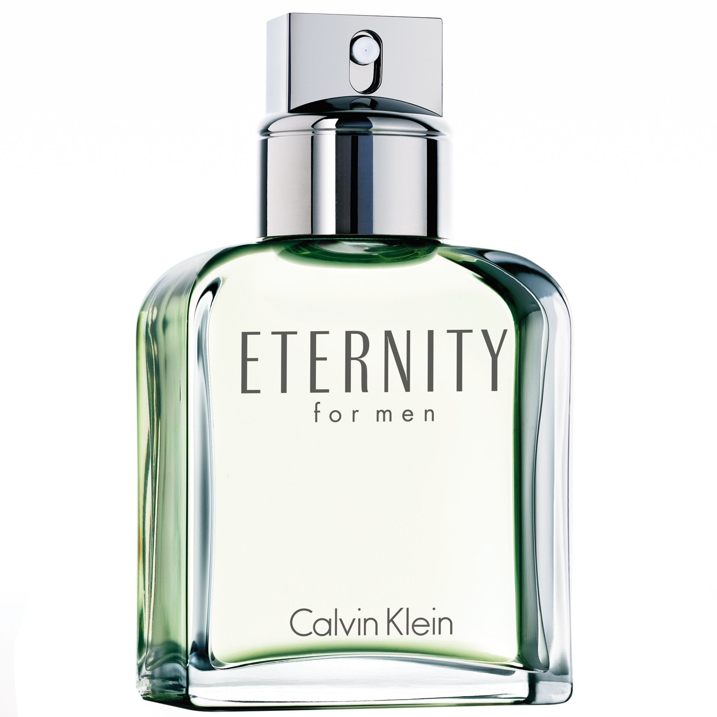

Slide 49
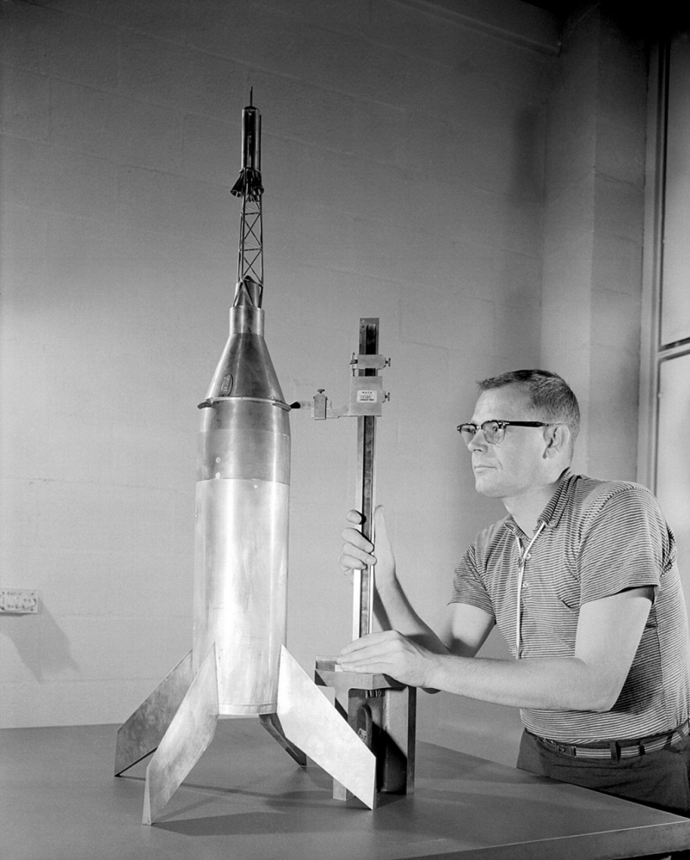

Slide 50

CAUTION: EXTREMELY DATED REFERENCE!!!!!

Slide 52
Now for
Non Judicial Foreclosure…

Slide 53


Slide 54

No Judges Need Apply

Slide 55
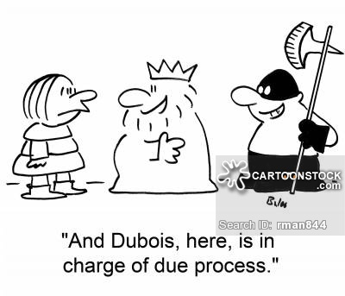
Due Process Does NOT Apply

Slide 56

Actually it’s “Power of Sale”

Slide 57
Default Notice Sent.

Slide 58
Notice of Sale Prepared..
Posted at Courthouse.
Published in Local Paper.

Slide 59
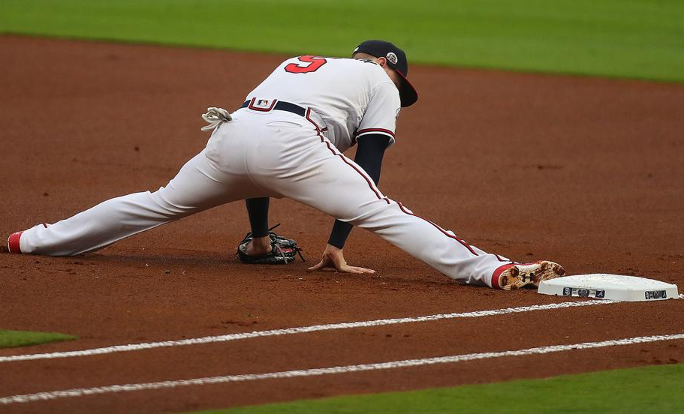
First Base – First Legal

Slide 60


Slide 61
Sheriff’s Auction

Slide 62
Sold…

Slide 63
Or…

Slide 64
Cancelled.

Slide 65


Slide 66
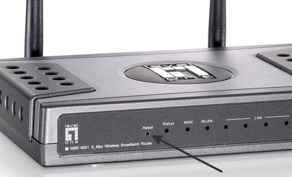
RESTART REQUIRED

Slide 67


Slide 68


Slide 69
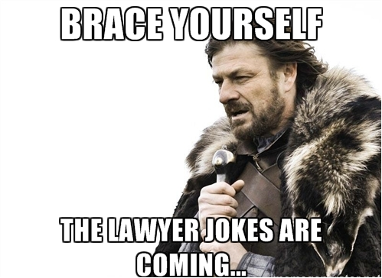

Slide 70


