Slide 1

Property Preservation 101

Slide 2

What is Property Preservation?
Property preservation is the process of maintaining the interior and exterior of a building. The purpose of preservation is to prevent the building, occupied or vacant, from falling into disrepair

Slide 3
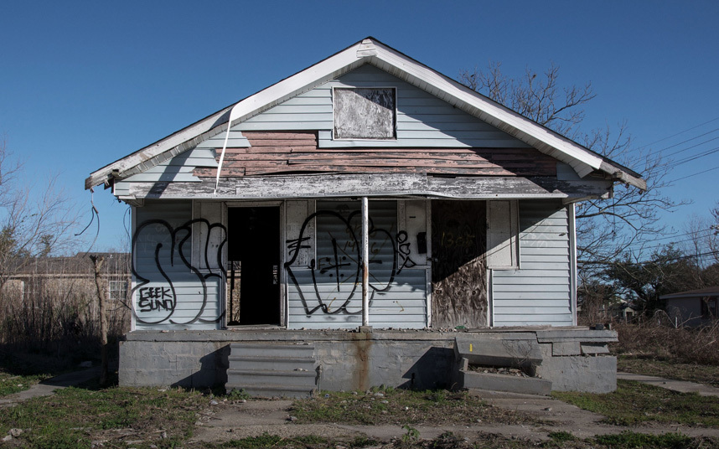
Examples of unpreserved property

Slide 4
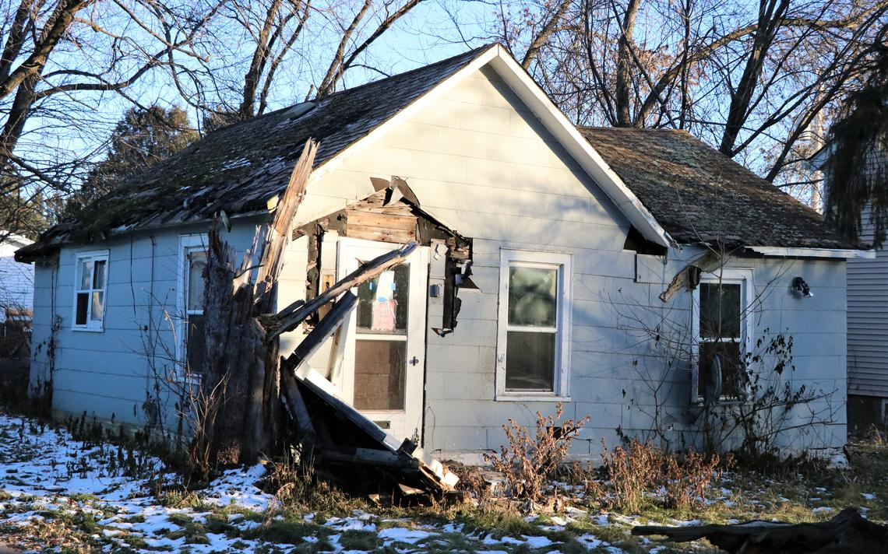

Slide 5
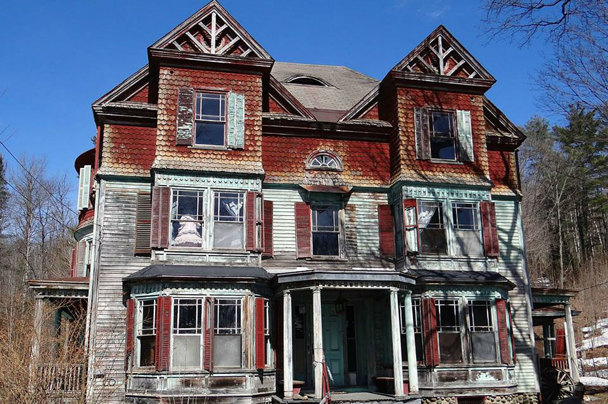
Some include human like objects in windows…

Slide 6
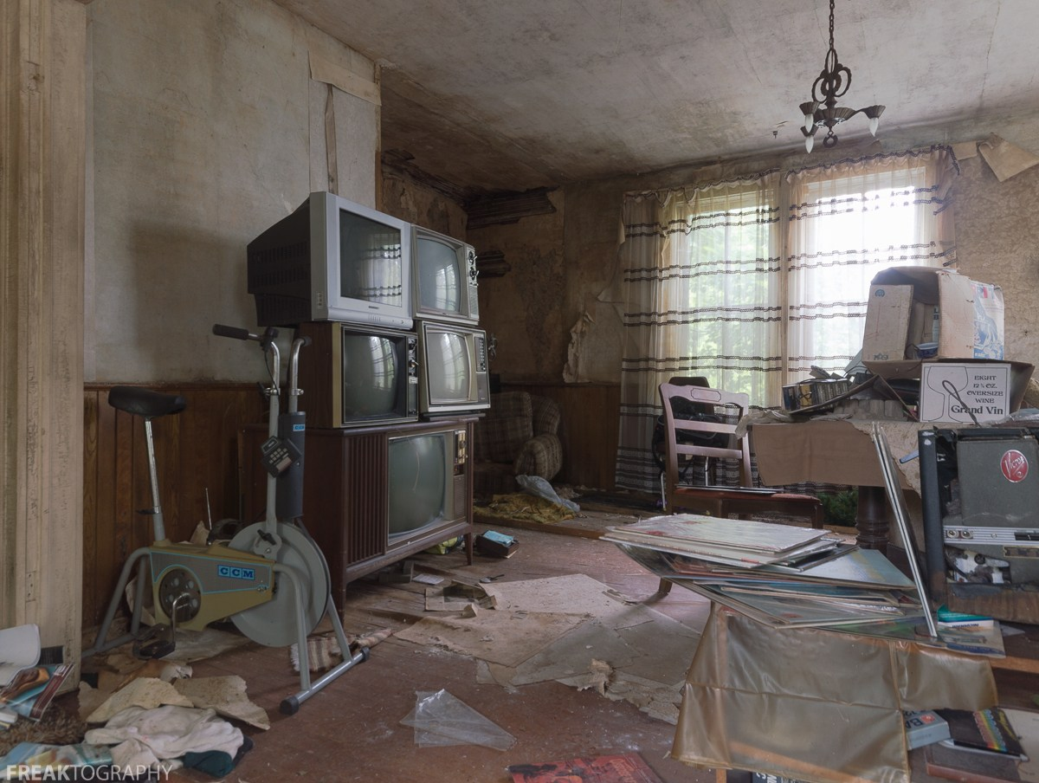
Some have peculiar collections of debris…

Slide 7
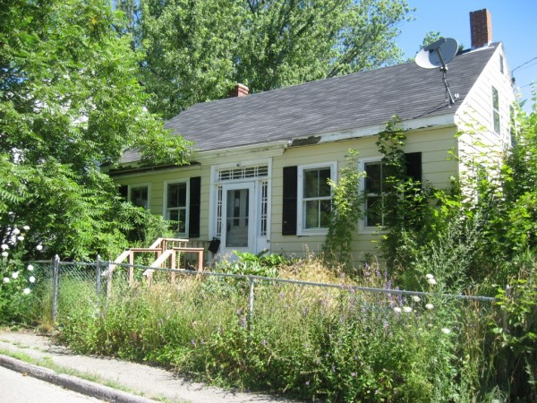
Some have simply never seen a weedwacker…

Slide 8

When pride of ownership is not enough to keep a property maintained, the lender must often step in to protect its security interest. Goals of property maintenance: - eliminate community blight - protect housing values - support neighborhood stabilization - minimize exposure to property damage - avoid/address liability for code violations - Be a Good Neighbor

Slide 9
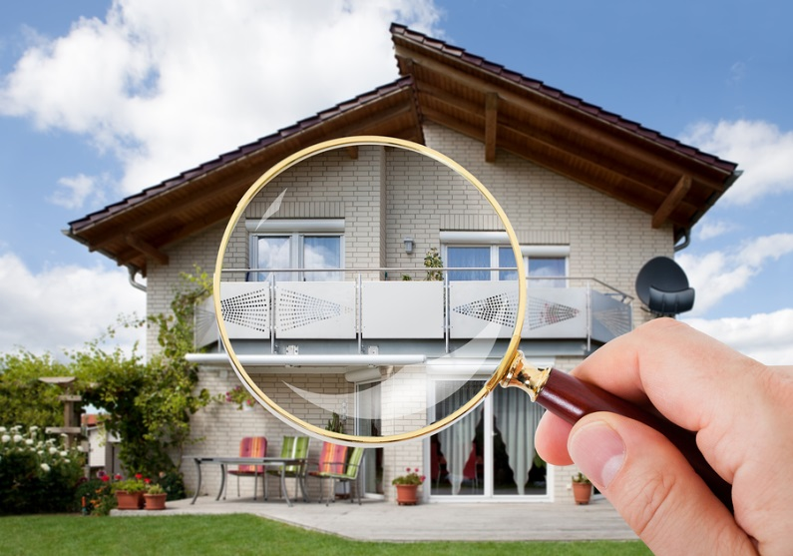

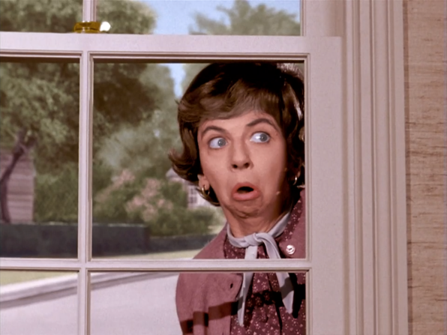
How does the servicer learn a property needs attention? Municipal Officials Neighbors Inspection

Slide 10

Key Buzzwords
Vacant/Abandoned Property
Real & Personal
Inspection
Occupancy
Mold, water intrusion, pests, biohazard remediation
FEMA inspections
Code Enforcement (fines/nuisance liens)
Condemnation/Demolition/Abatement
Securing Property
Winterizing Property
Hazard Insurance claims
Registration
Debris Removal/Trash out

Slide 11

Servicer’s Basic Rights and Responsibilities – Where do they come from?
Contractual Rights and Obligations – the mortgage
State Statutes & Local Ordinances
Case Law

Slide 12
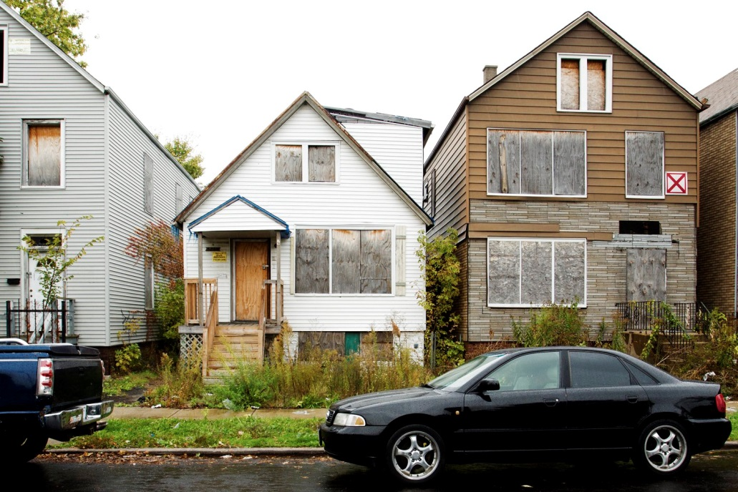
Vacant & Abandoned Property
Property Inspections
Registration
Securing Property
Maintaining Property
- Pre-Sale
- Post-Sale
What if personal property was left behind?

Slide 13
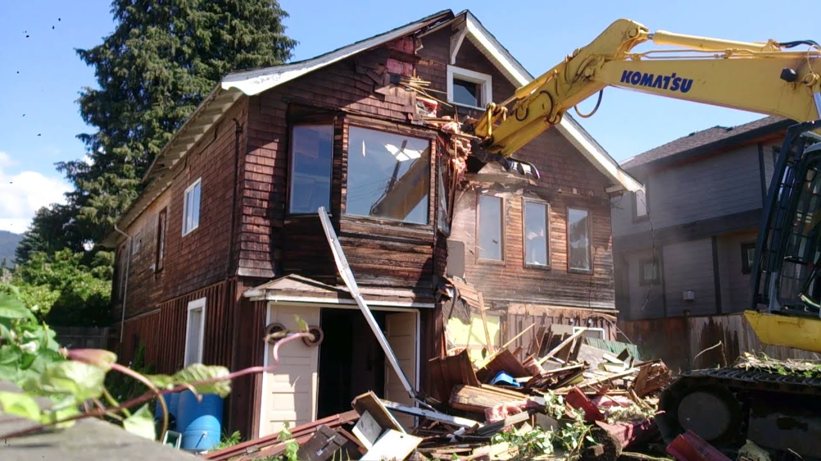
Distressed Property
Code Violations
Eminent Domain & Condemnation
Demolition
Complaints from Neighbors and Public Officials

Slide 14
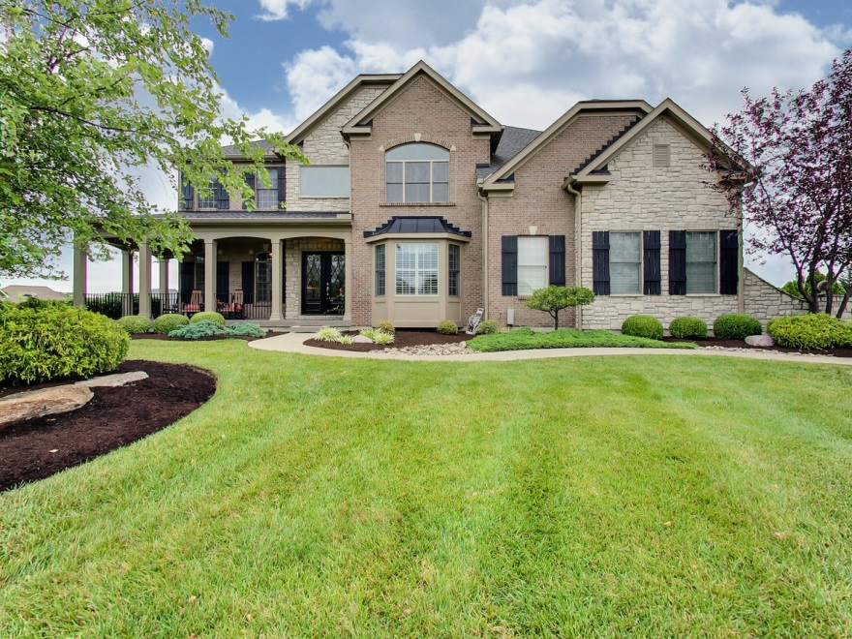
#GOALS

